Slide 1
COVID-CNS SQL Database User Guide
The COVID-CNS SQL Database is known as “PhenoDB”.
There are various database tools/clients that can be used to access the Database. We suggest using DBeaver, and this guide will include instructions specific to this client.
The first step is to download and set-up Dbeaver onto your computer.
https://dbeaver.io/download/
For PC users, select Windows (installer).
For Mac users, - for “M” series users, download MacOS for Apple Silicon. For non “M” series, download MacOS for Intel. To find out which Mac computer you have, click on the Apple icon, then select “About This Mac”.

Slide 2
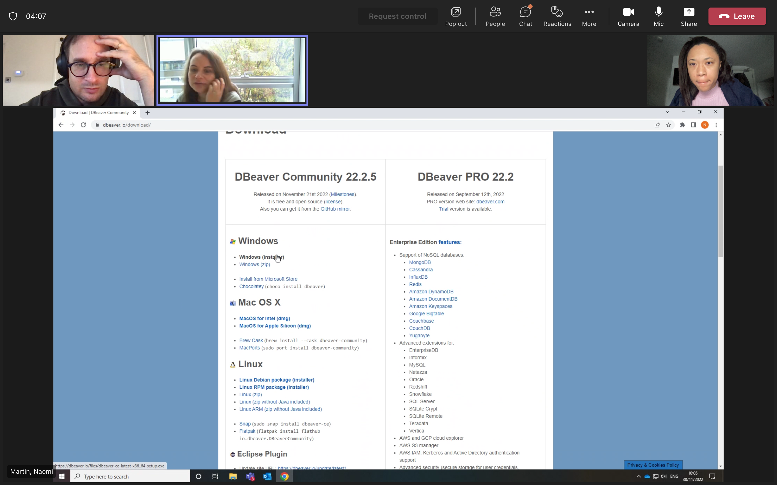
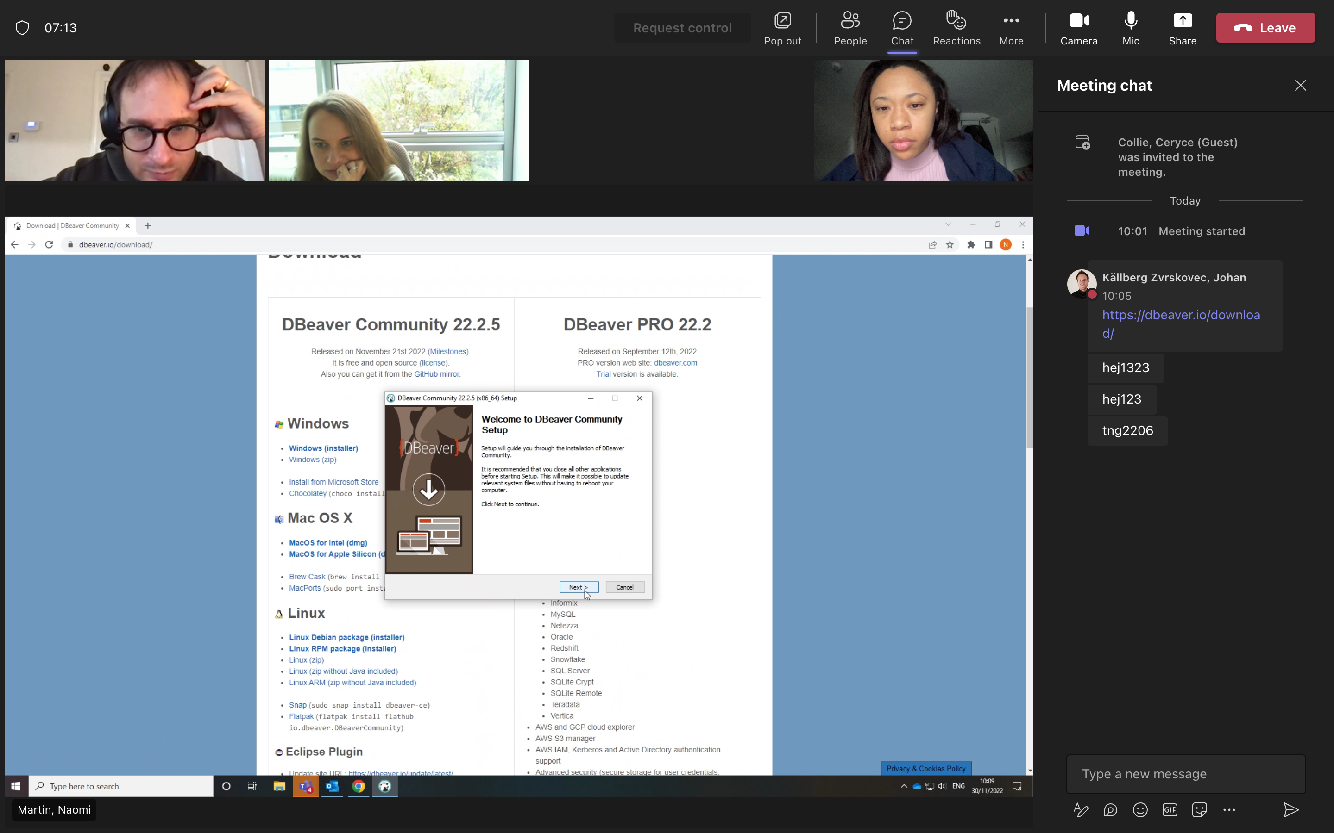
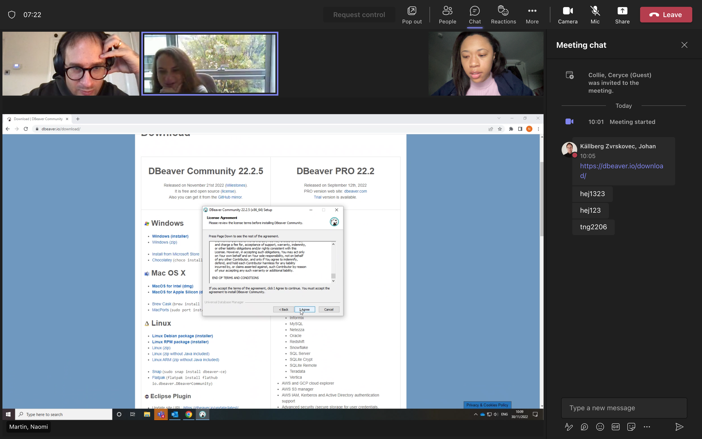
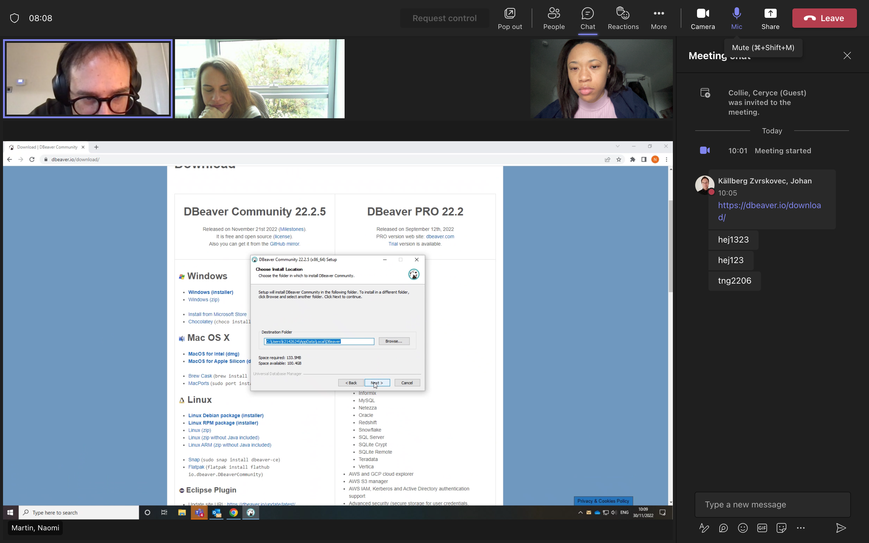
Section 1: Downloading the client (DBeaver)
1
2
3
4

Slide 3
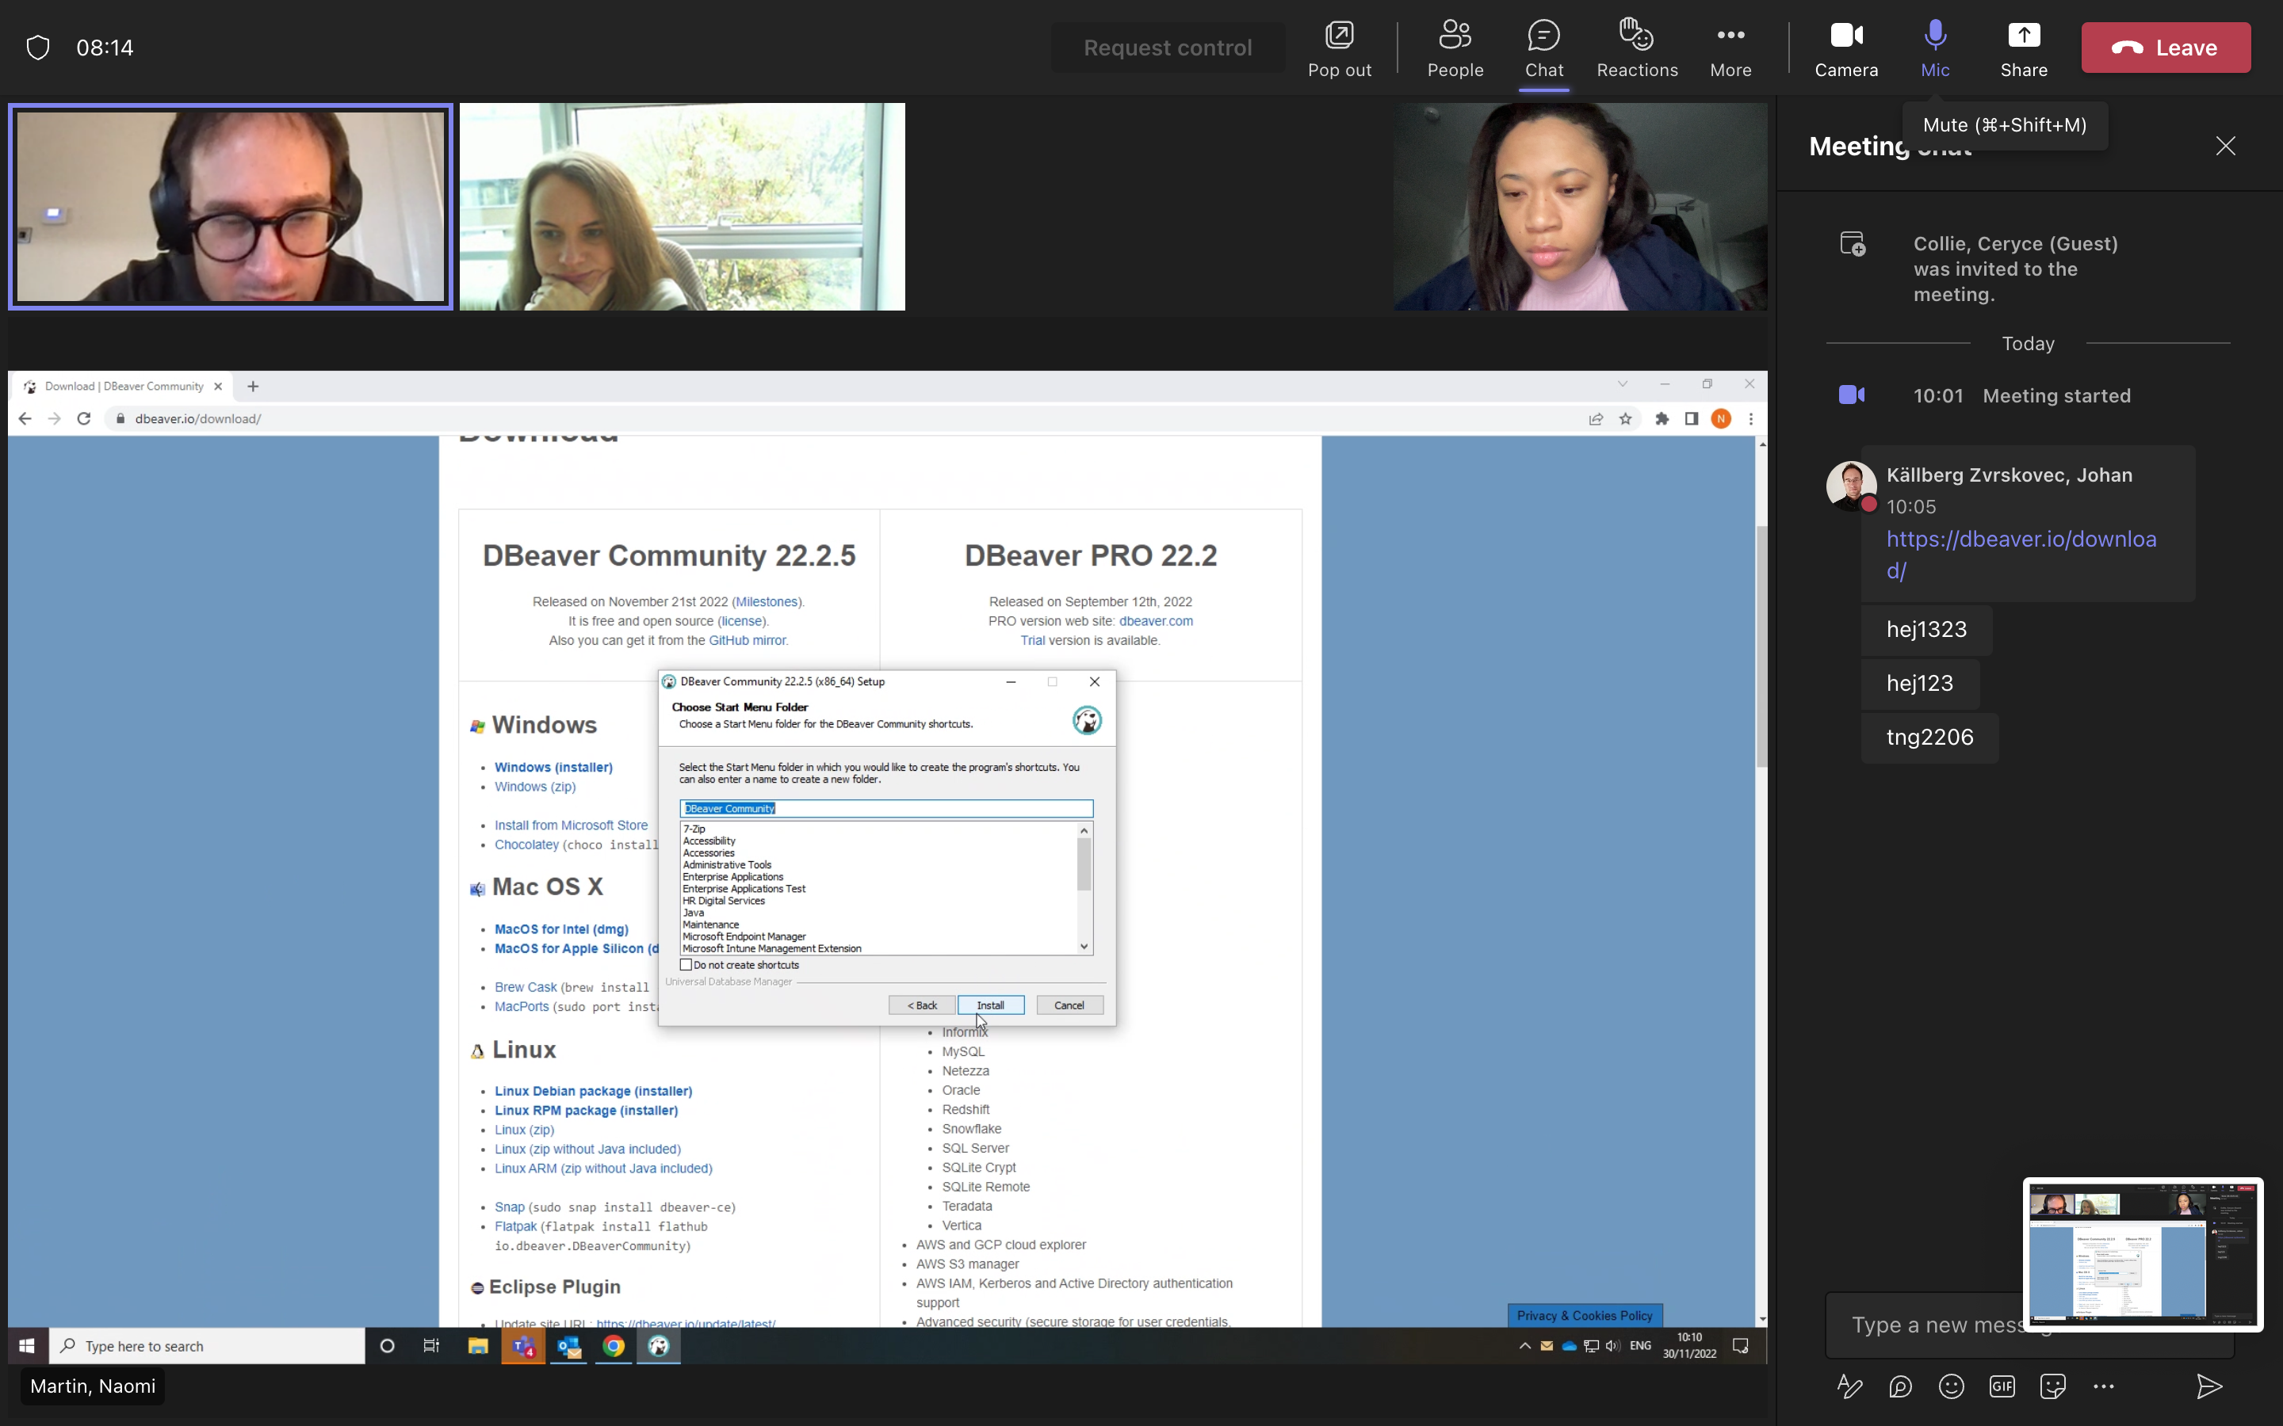
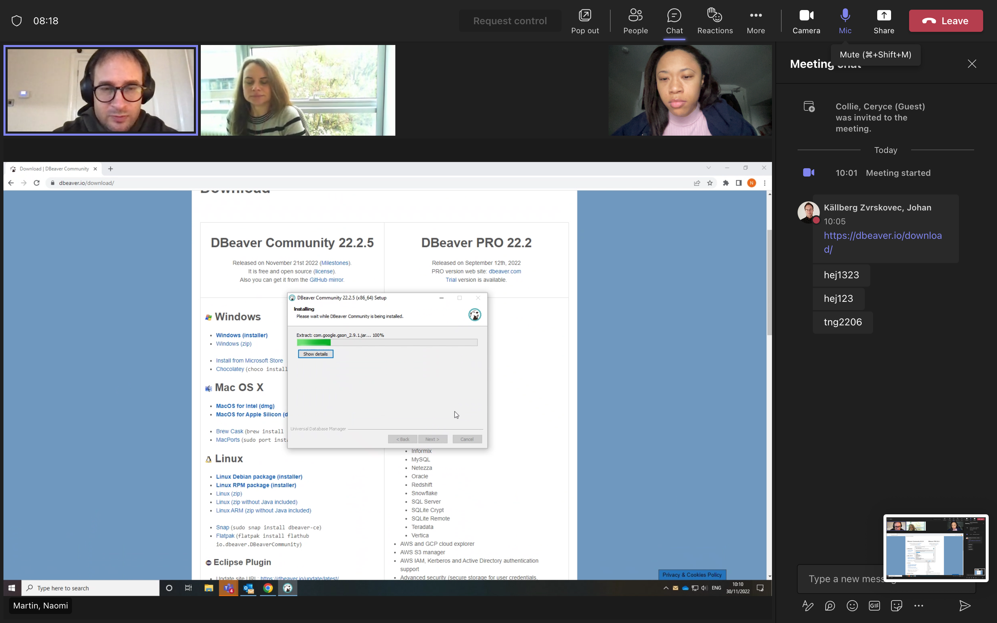
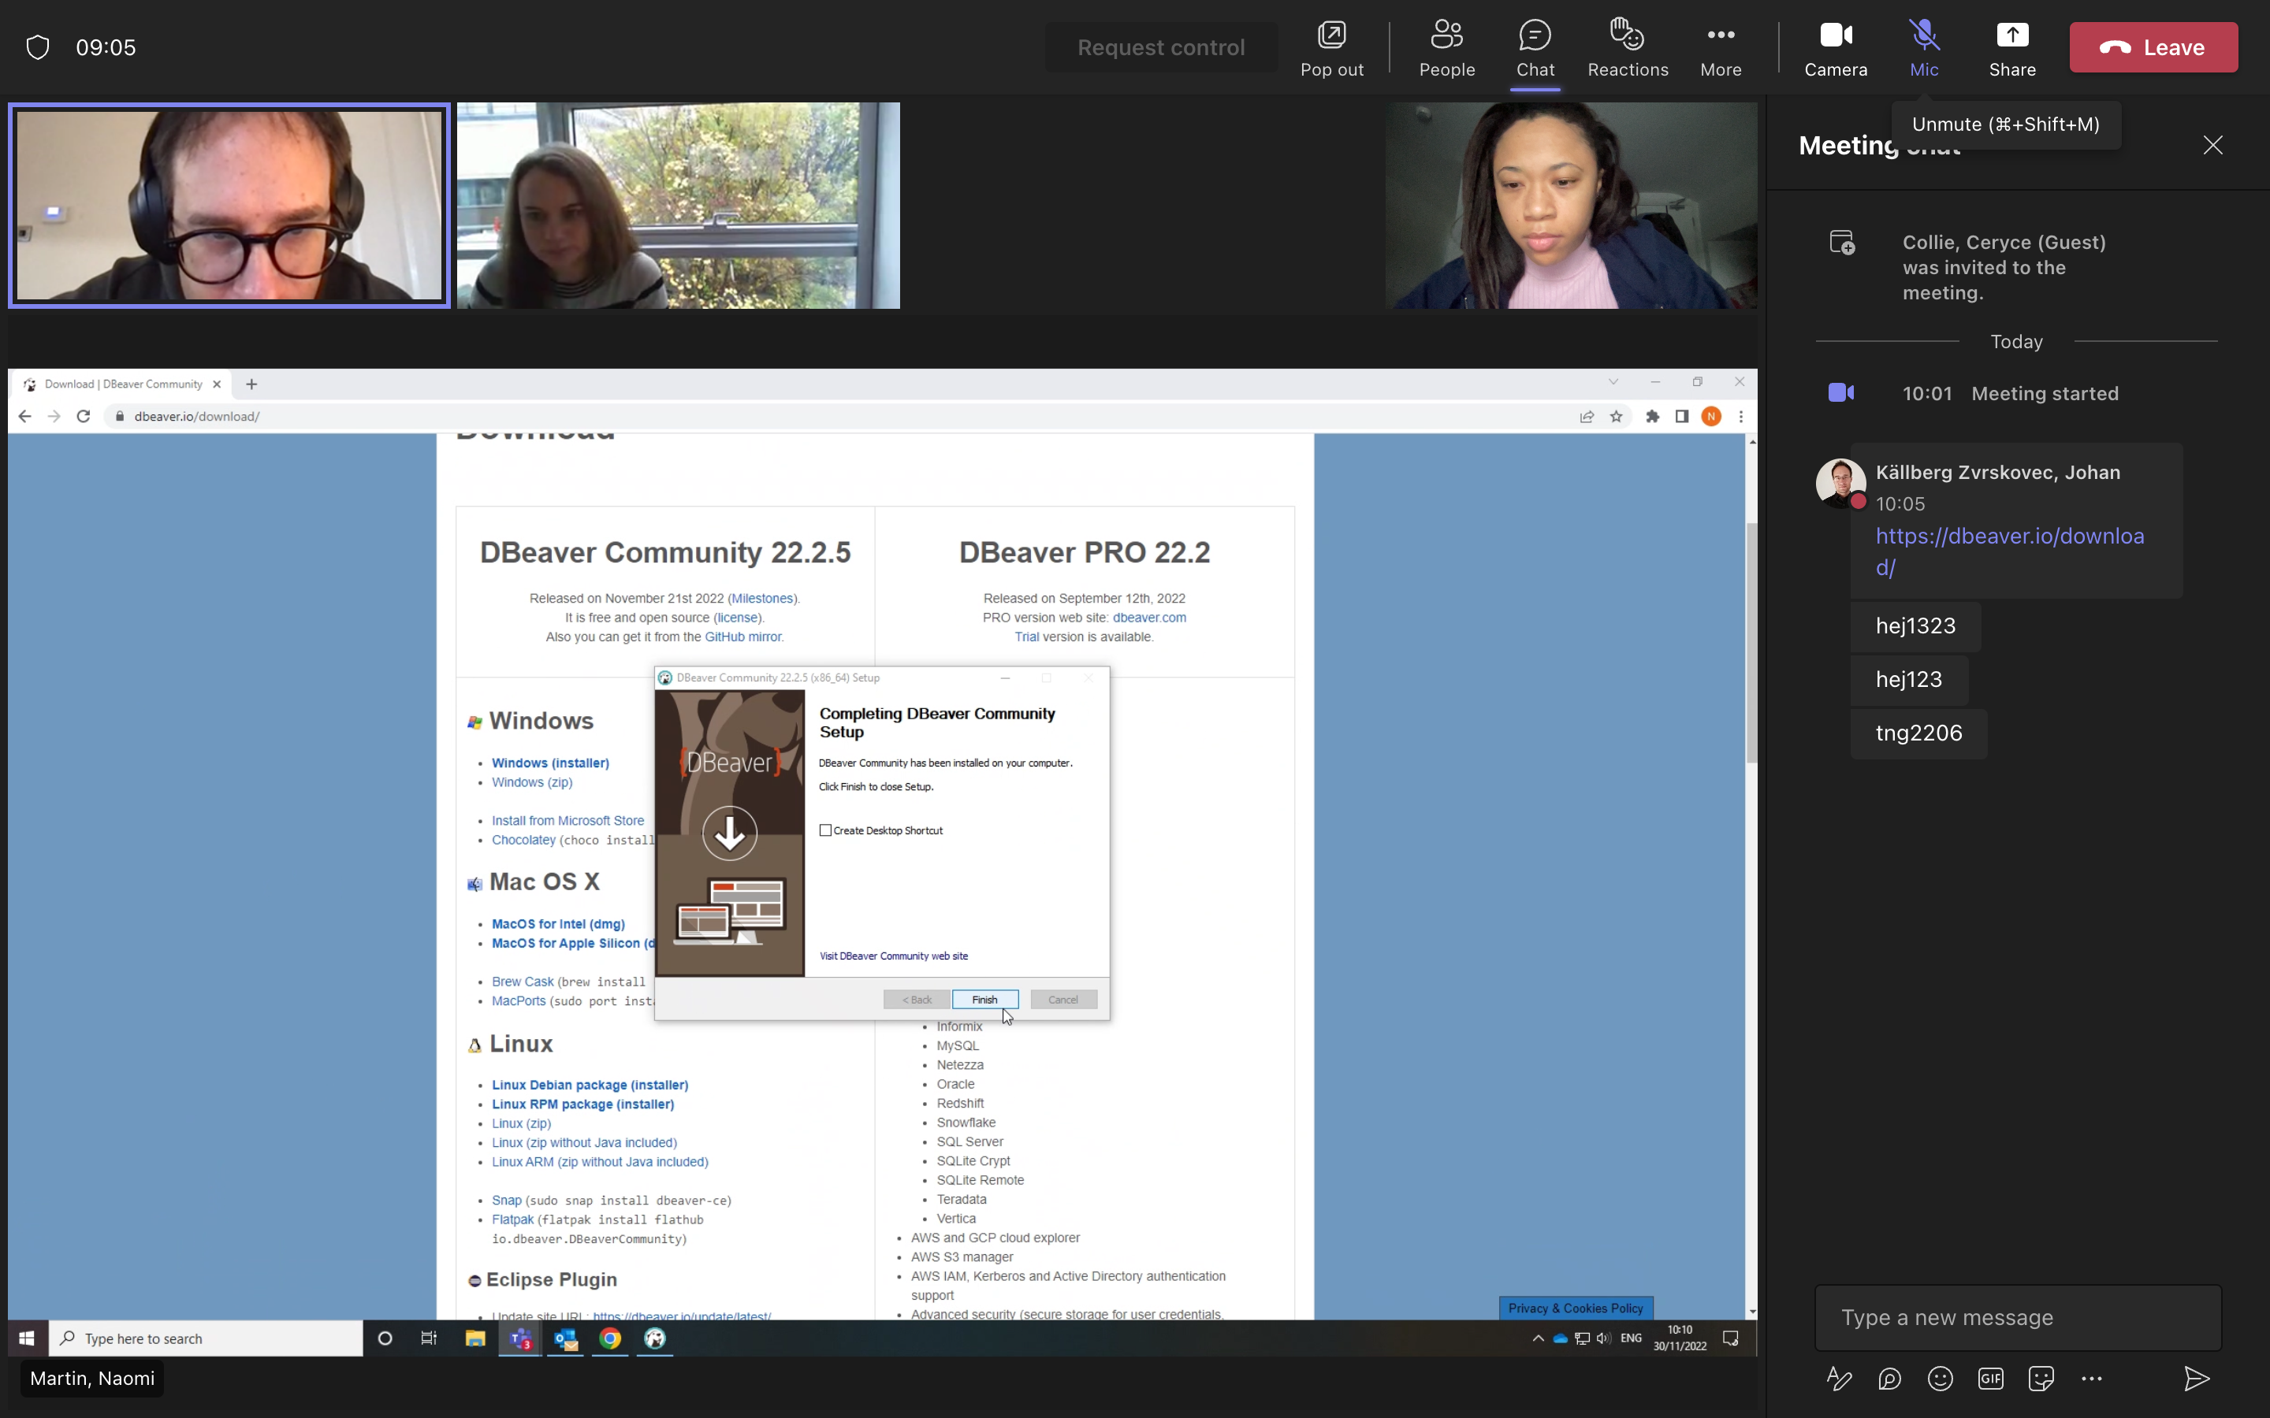
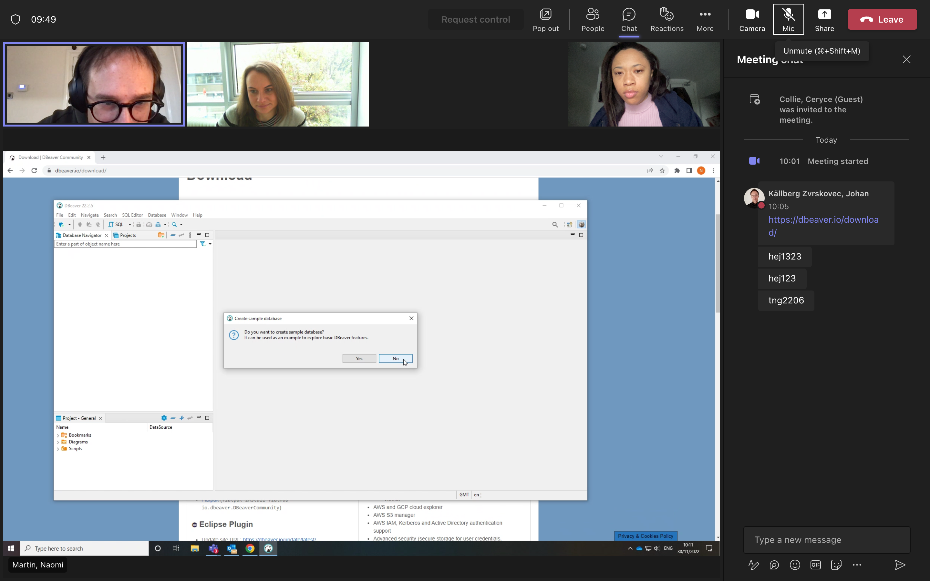
5
6
7
8

Slide 4
Section 2: Connect to database and SSH tunnel
To access the PhenoDB database, you need to connect to the database itself and to the SSH Tunnel.
You will therefore be given two separate usernames and passwords, one for the database, and one for the SSH Tunnel.
When connecting to the database and SSH Tunnel, you will need to copy the below host names and paste them into the respective ”Host” fields. Further details are provided on page 5.
Database Connection
Host: postgresql-cluster.cluster-cjghupwohy3q.eu-west-2.rds.amazonaws.com
SSH Tunnel
Host: vpn.bredcap.org.uk

Slide 5
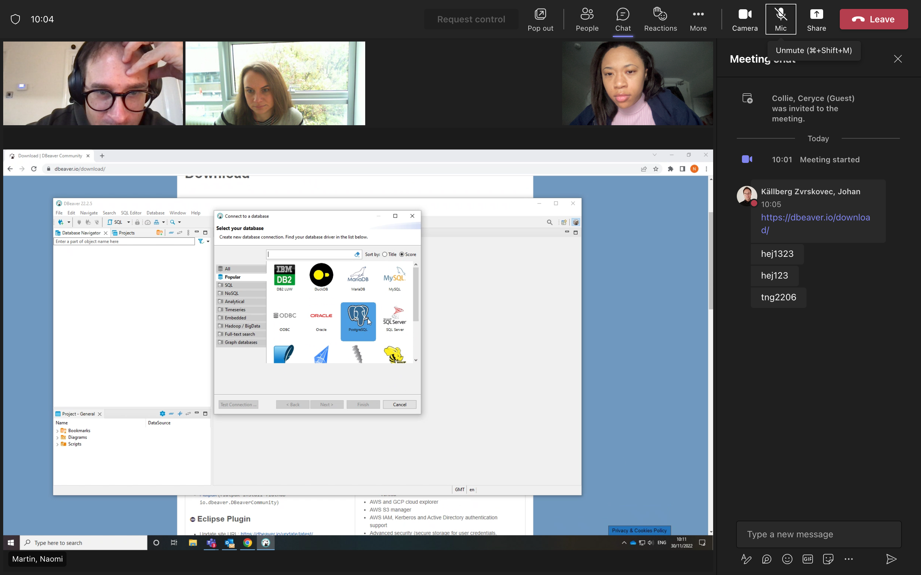
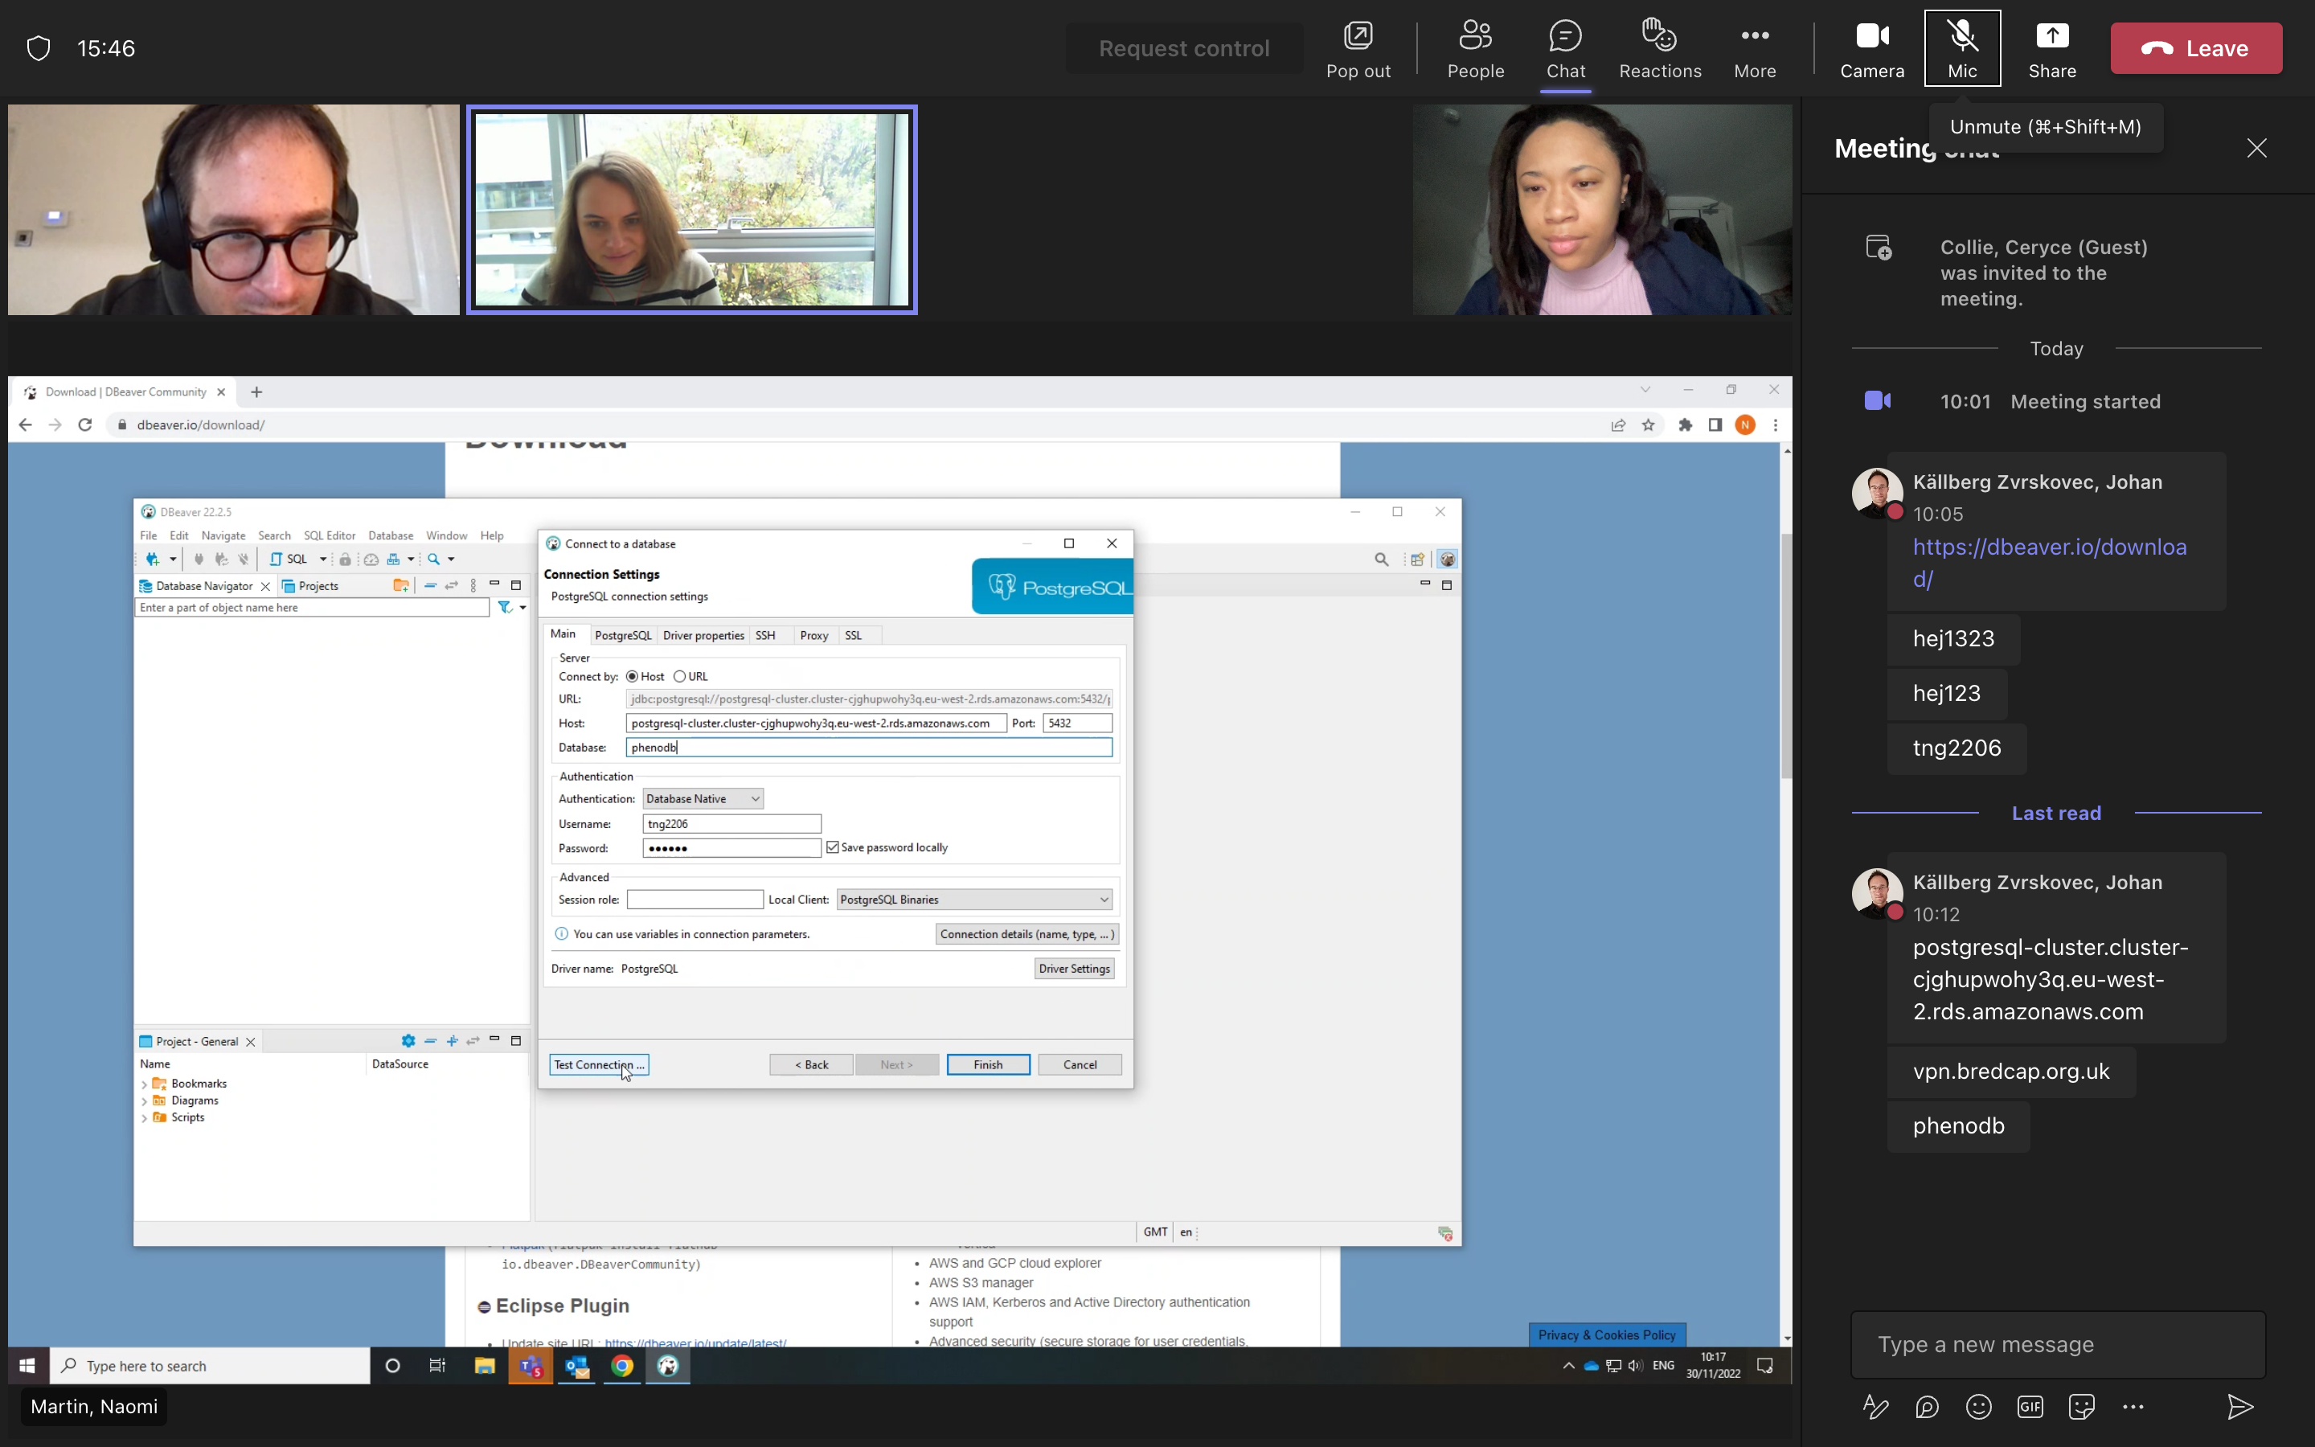
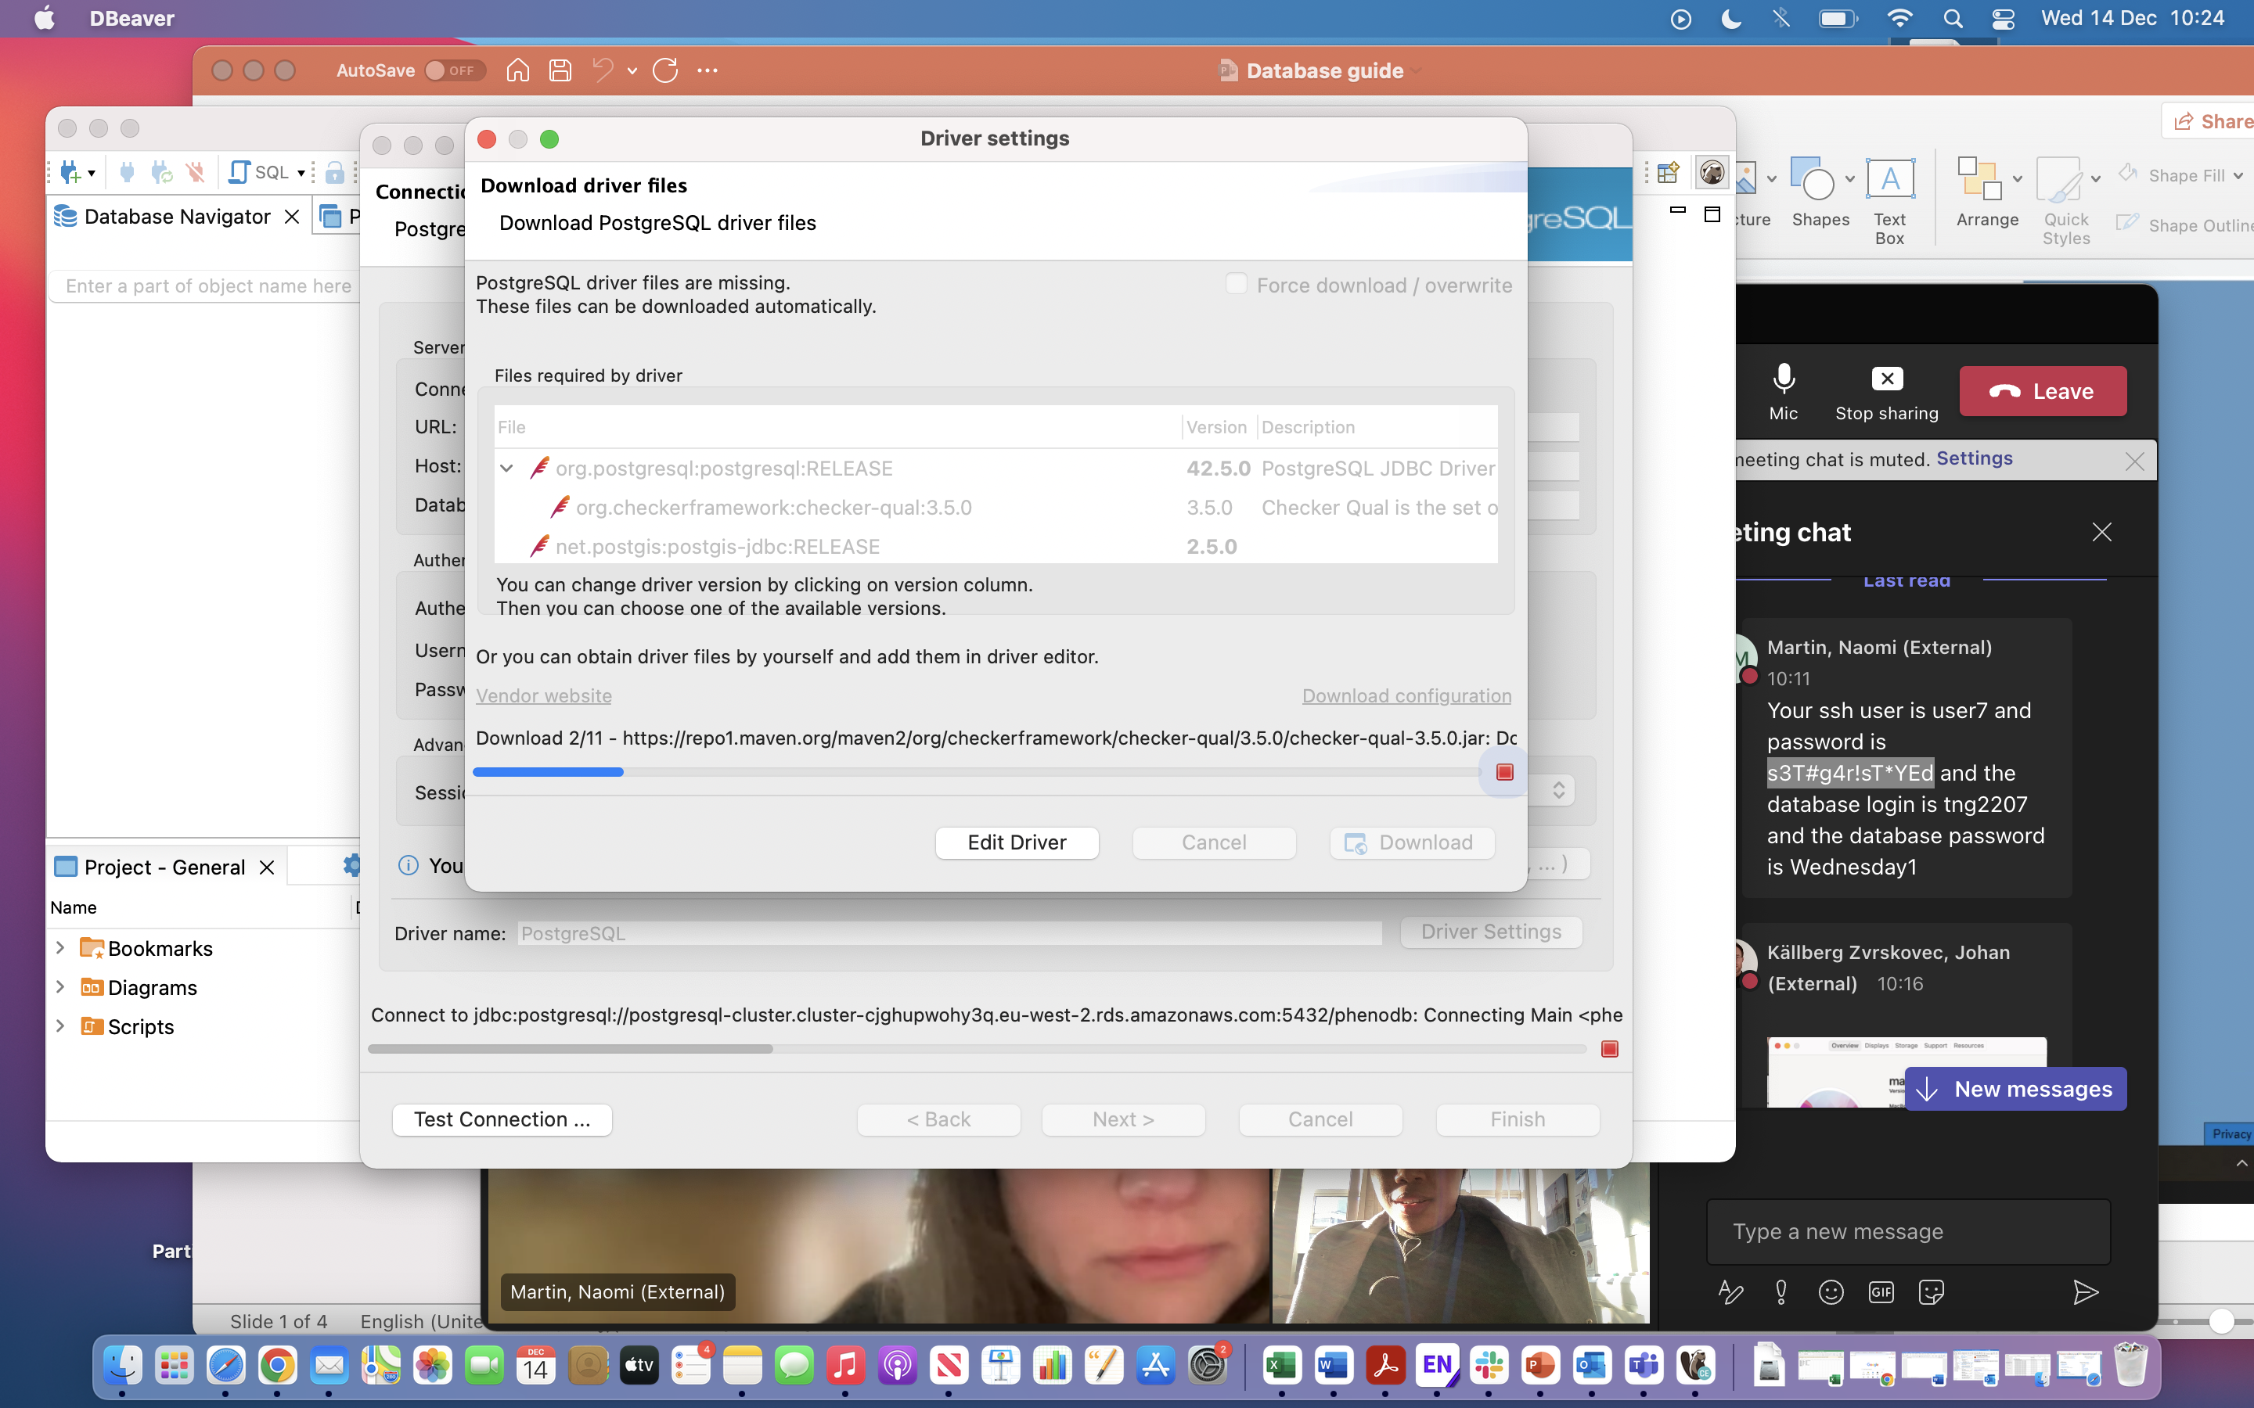
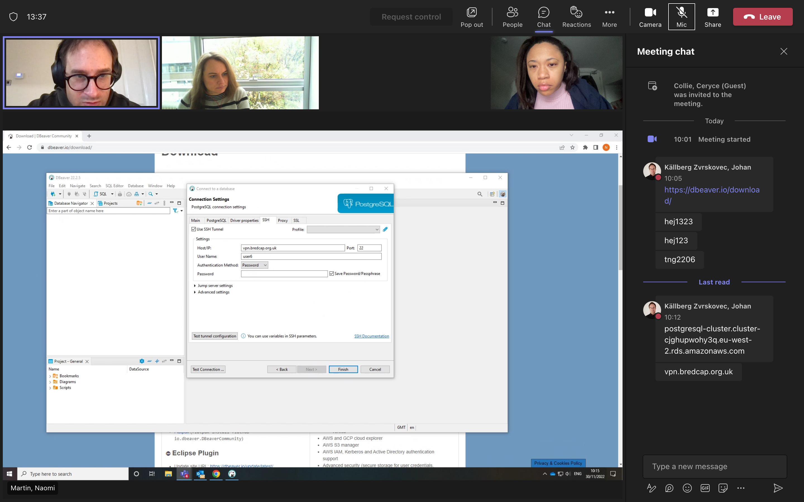
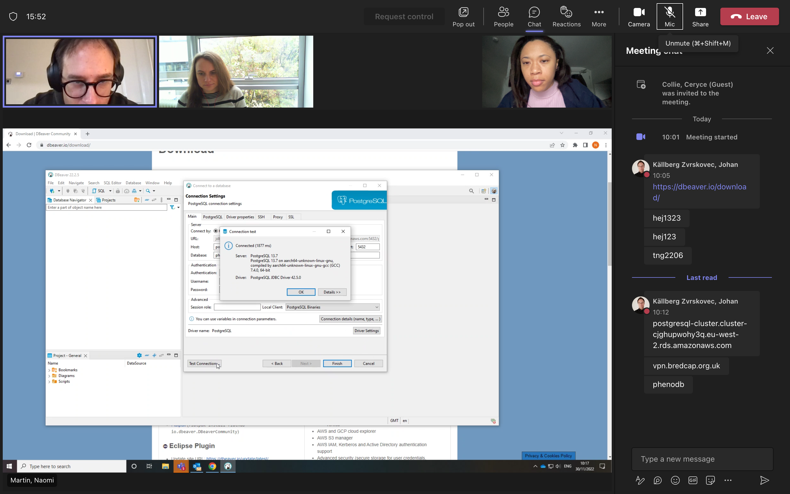
Section 2: Connect to database and SSH tunnel
Go to the Database menu, then select New Database Connection.
Change the host to: postgresql-cluster.cluster-cjghupwohy3q.eu-west-2.rds.amazonaws.com, and Database to: phenodb.
1
2
3
Press Download to download driver files. You should only need to do this the first time.
Select PostgreSQL, then click Next.
Enter your database login username and password. Click Test Connection.
4
Set up the SSH Tunnel. Select SSH. Enter the host as: vpn.bredcap.org.uk. Enter your SSH username and password.
5
Click Test Connection, then OK, and then Finish.

Slide 6
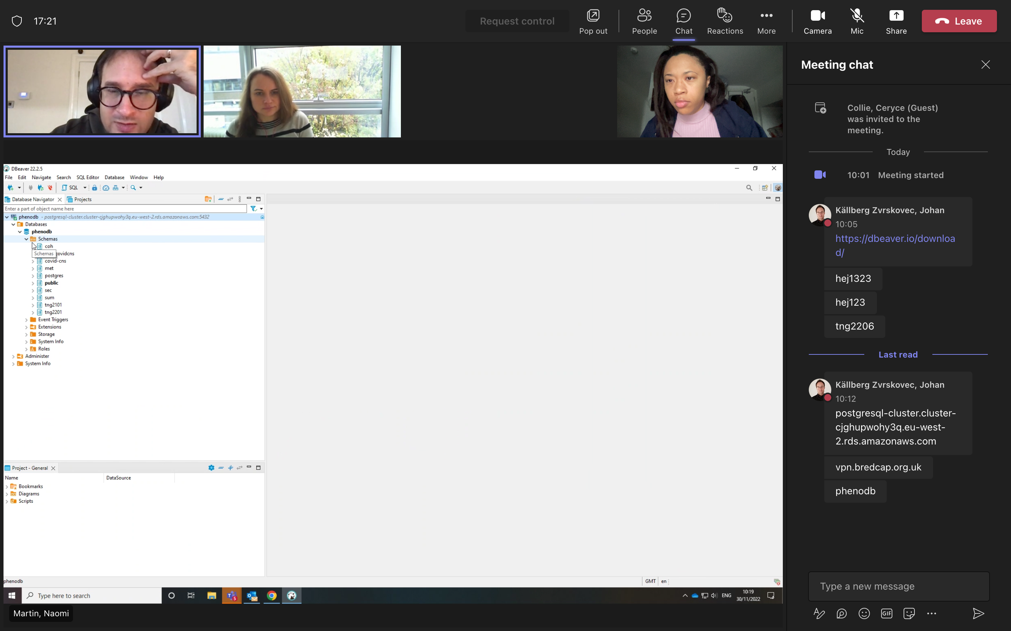
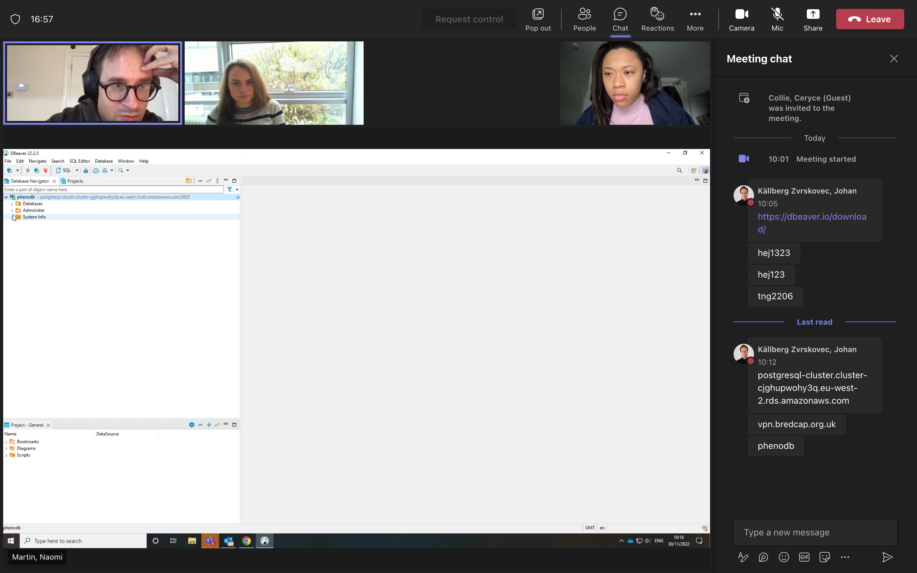
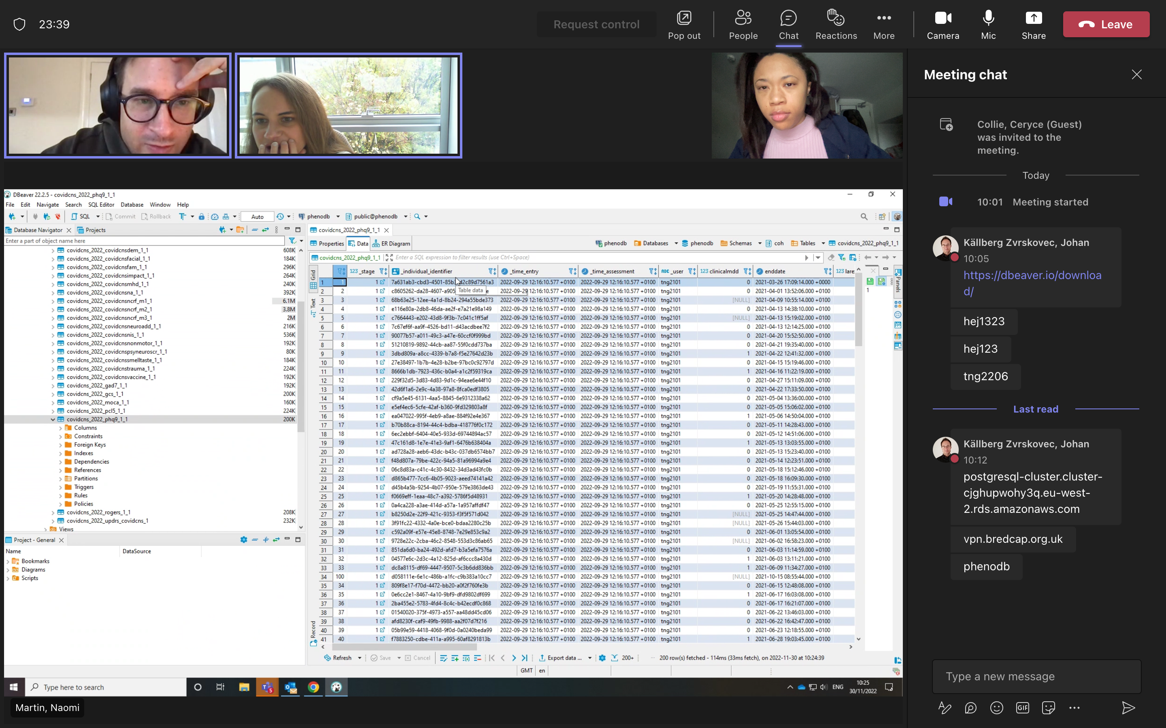
Section 3: Navigating the database and viewing data
1
2
Open the drop-down menu for Schemas. Secure data (data with an identifier) is stored under “Sec”. Open this drop-down menu. Data is stored under Tables. Under Tables, there are two options. The Individual table holds individual level data. The Individual_cohortinstance_identifier table holds individual level data linked to the COVID-CNS ID. Right click on ‘Individual_cohortinstance_identifier’, then select ‘View Data’. This is where participants’ identifiable data (name, address, contact details etc) is stored. You will only be able to view this data if you have been given access to this.
3
Under Schemas, “coh” (Cohort data) also stores individual level data but without study identifiers.

Slide 7
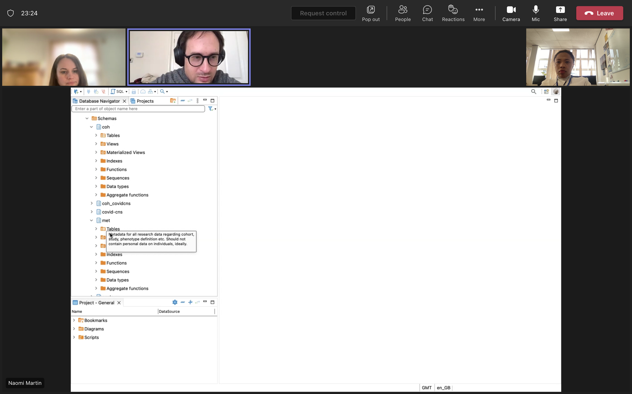
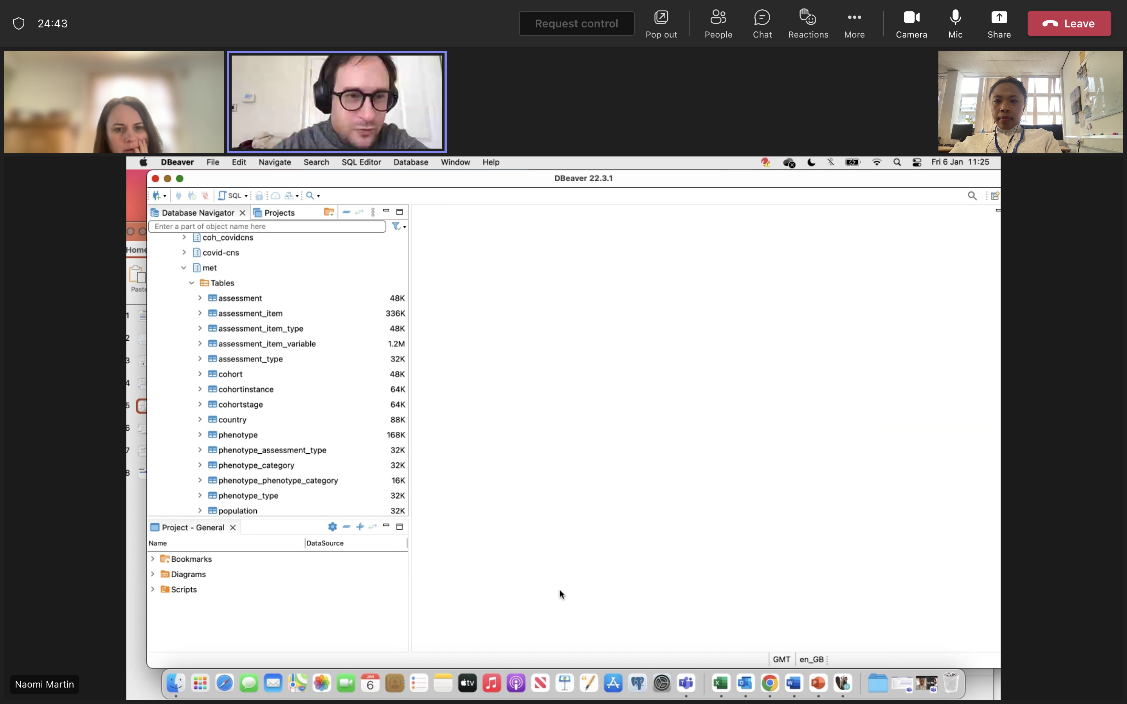
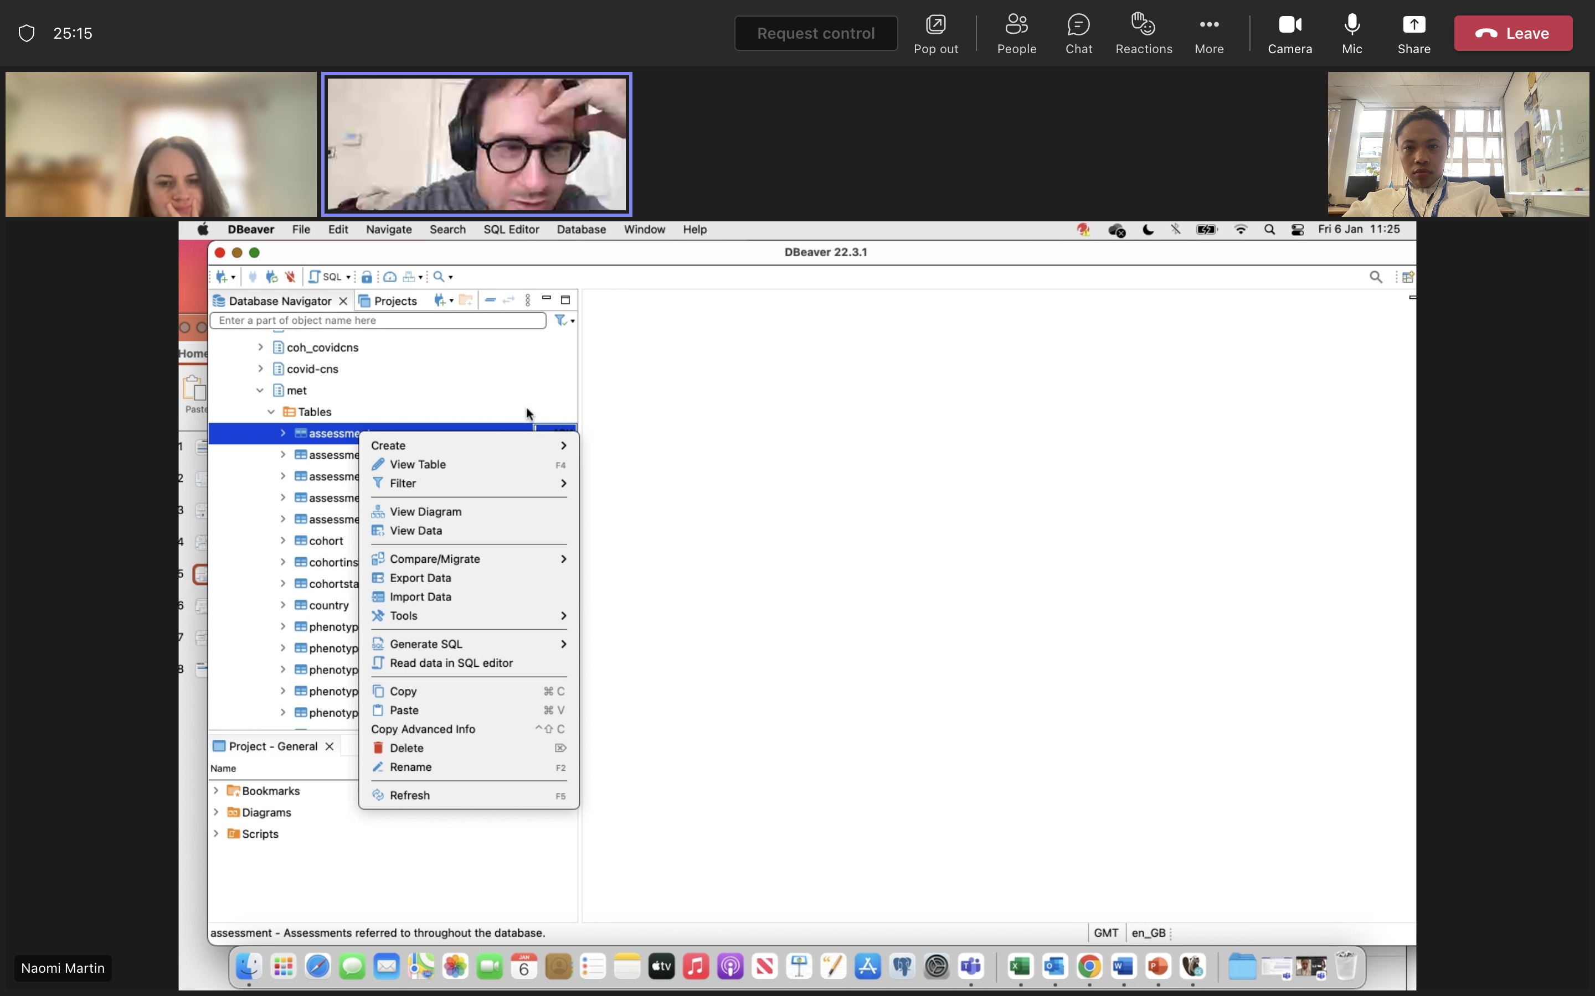
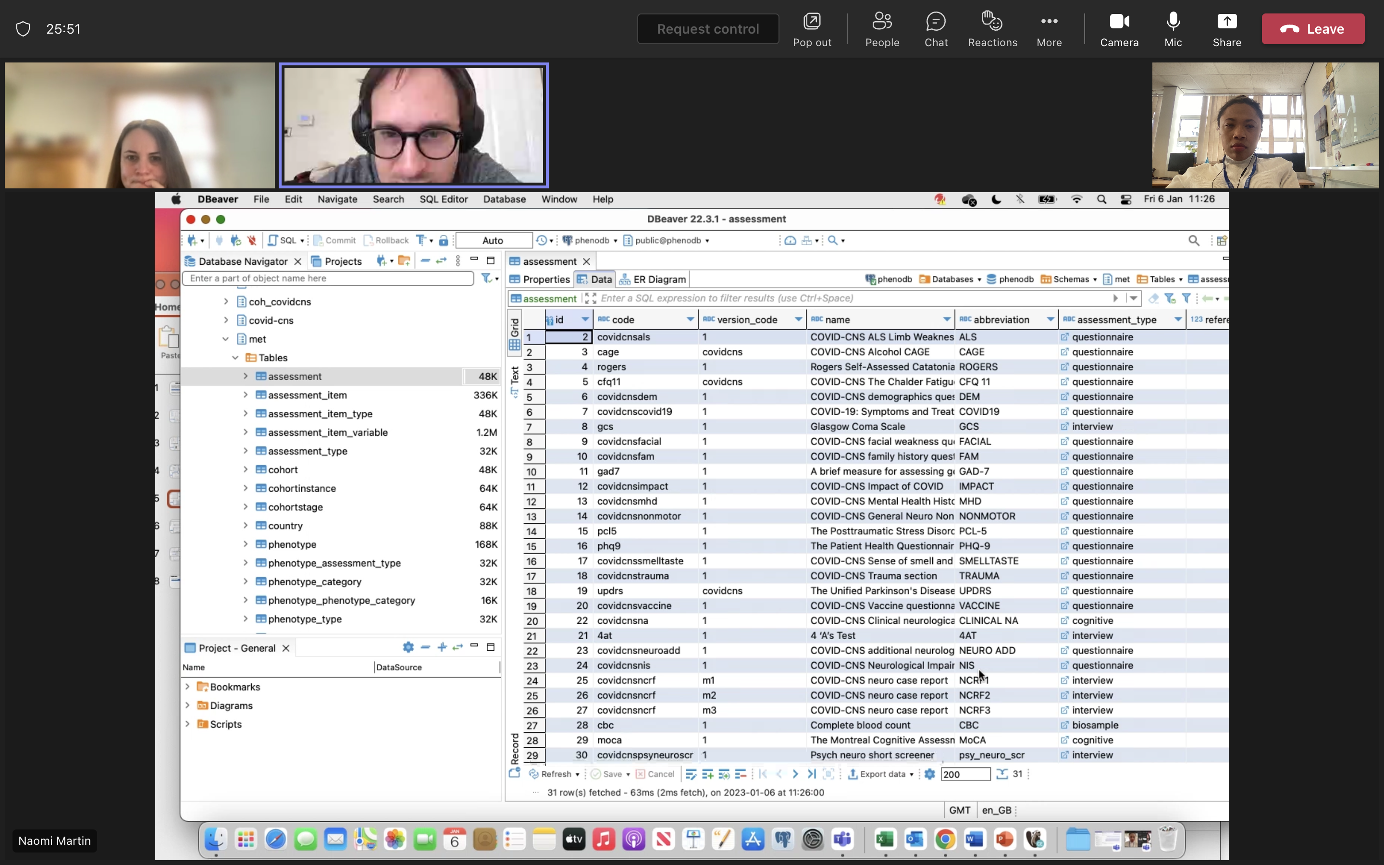
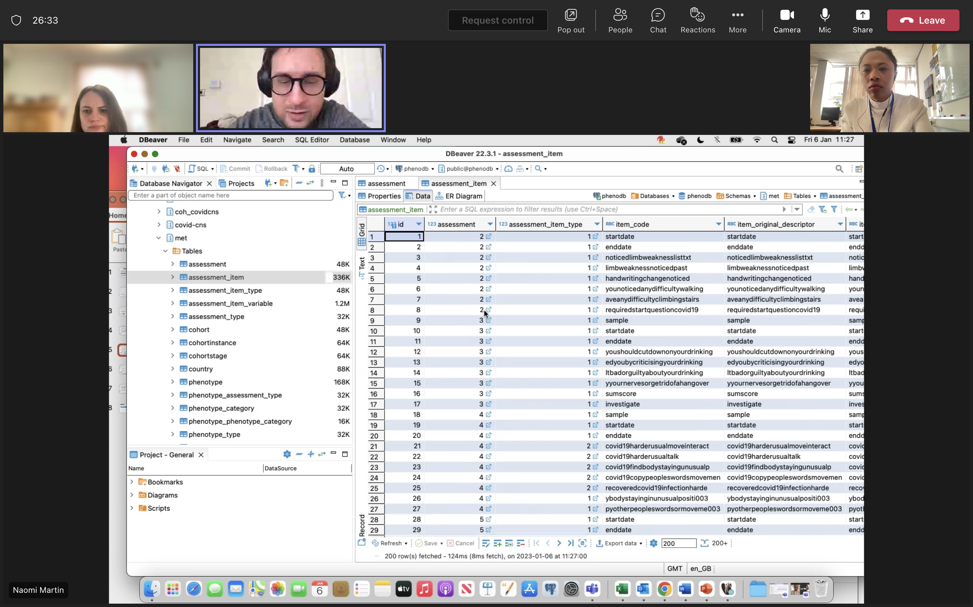
4
5
The “Met” schema refers to metadata, which provides information on the various kinds of data held in the database.
6
A list of categories is available under “Tables”.
For example, a list of assessments or diagnostic instruments within questionnaires can be obtained….
7
8
…as well as individual items within assessments.

Slide 8
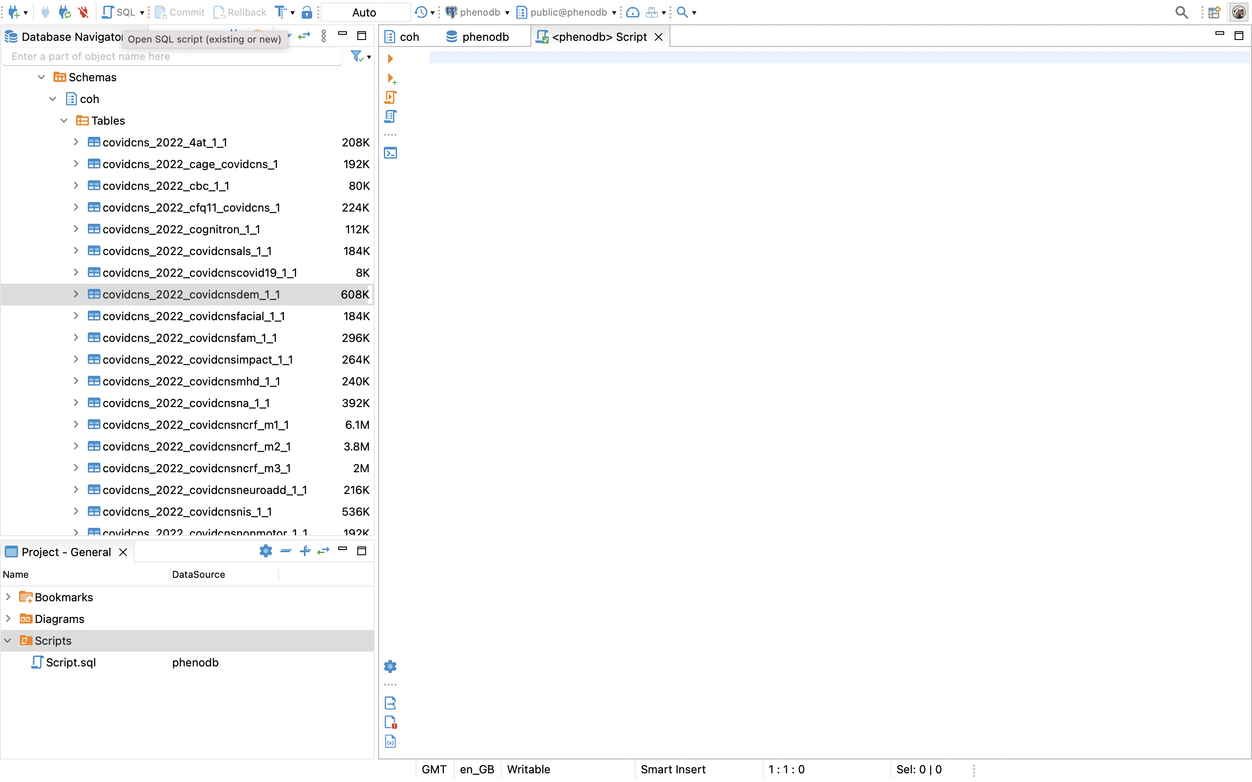
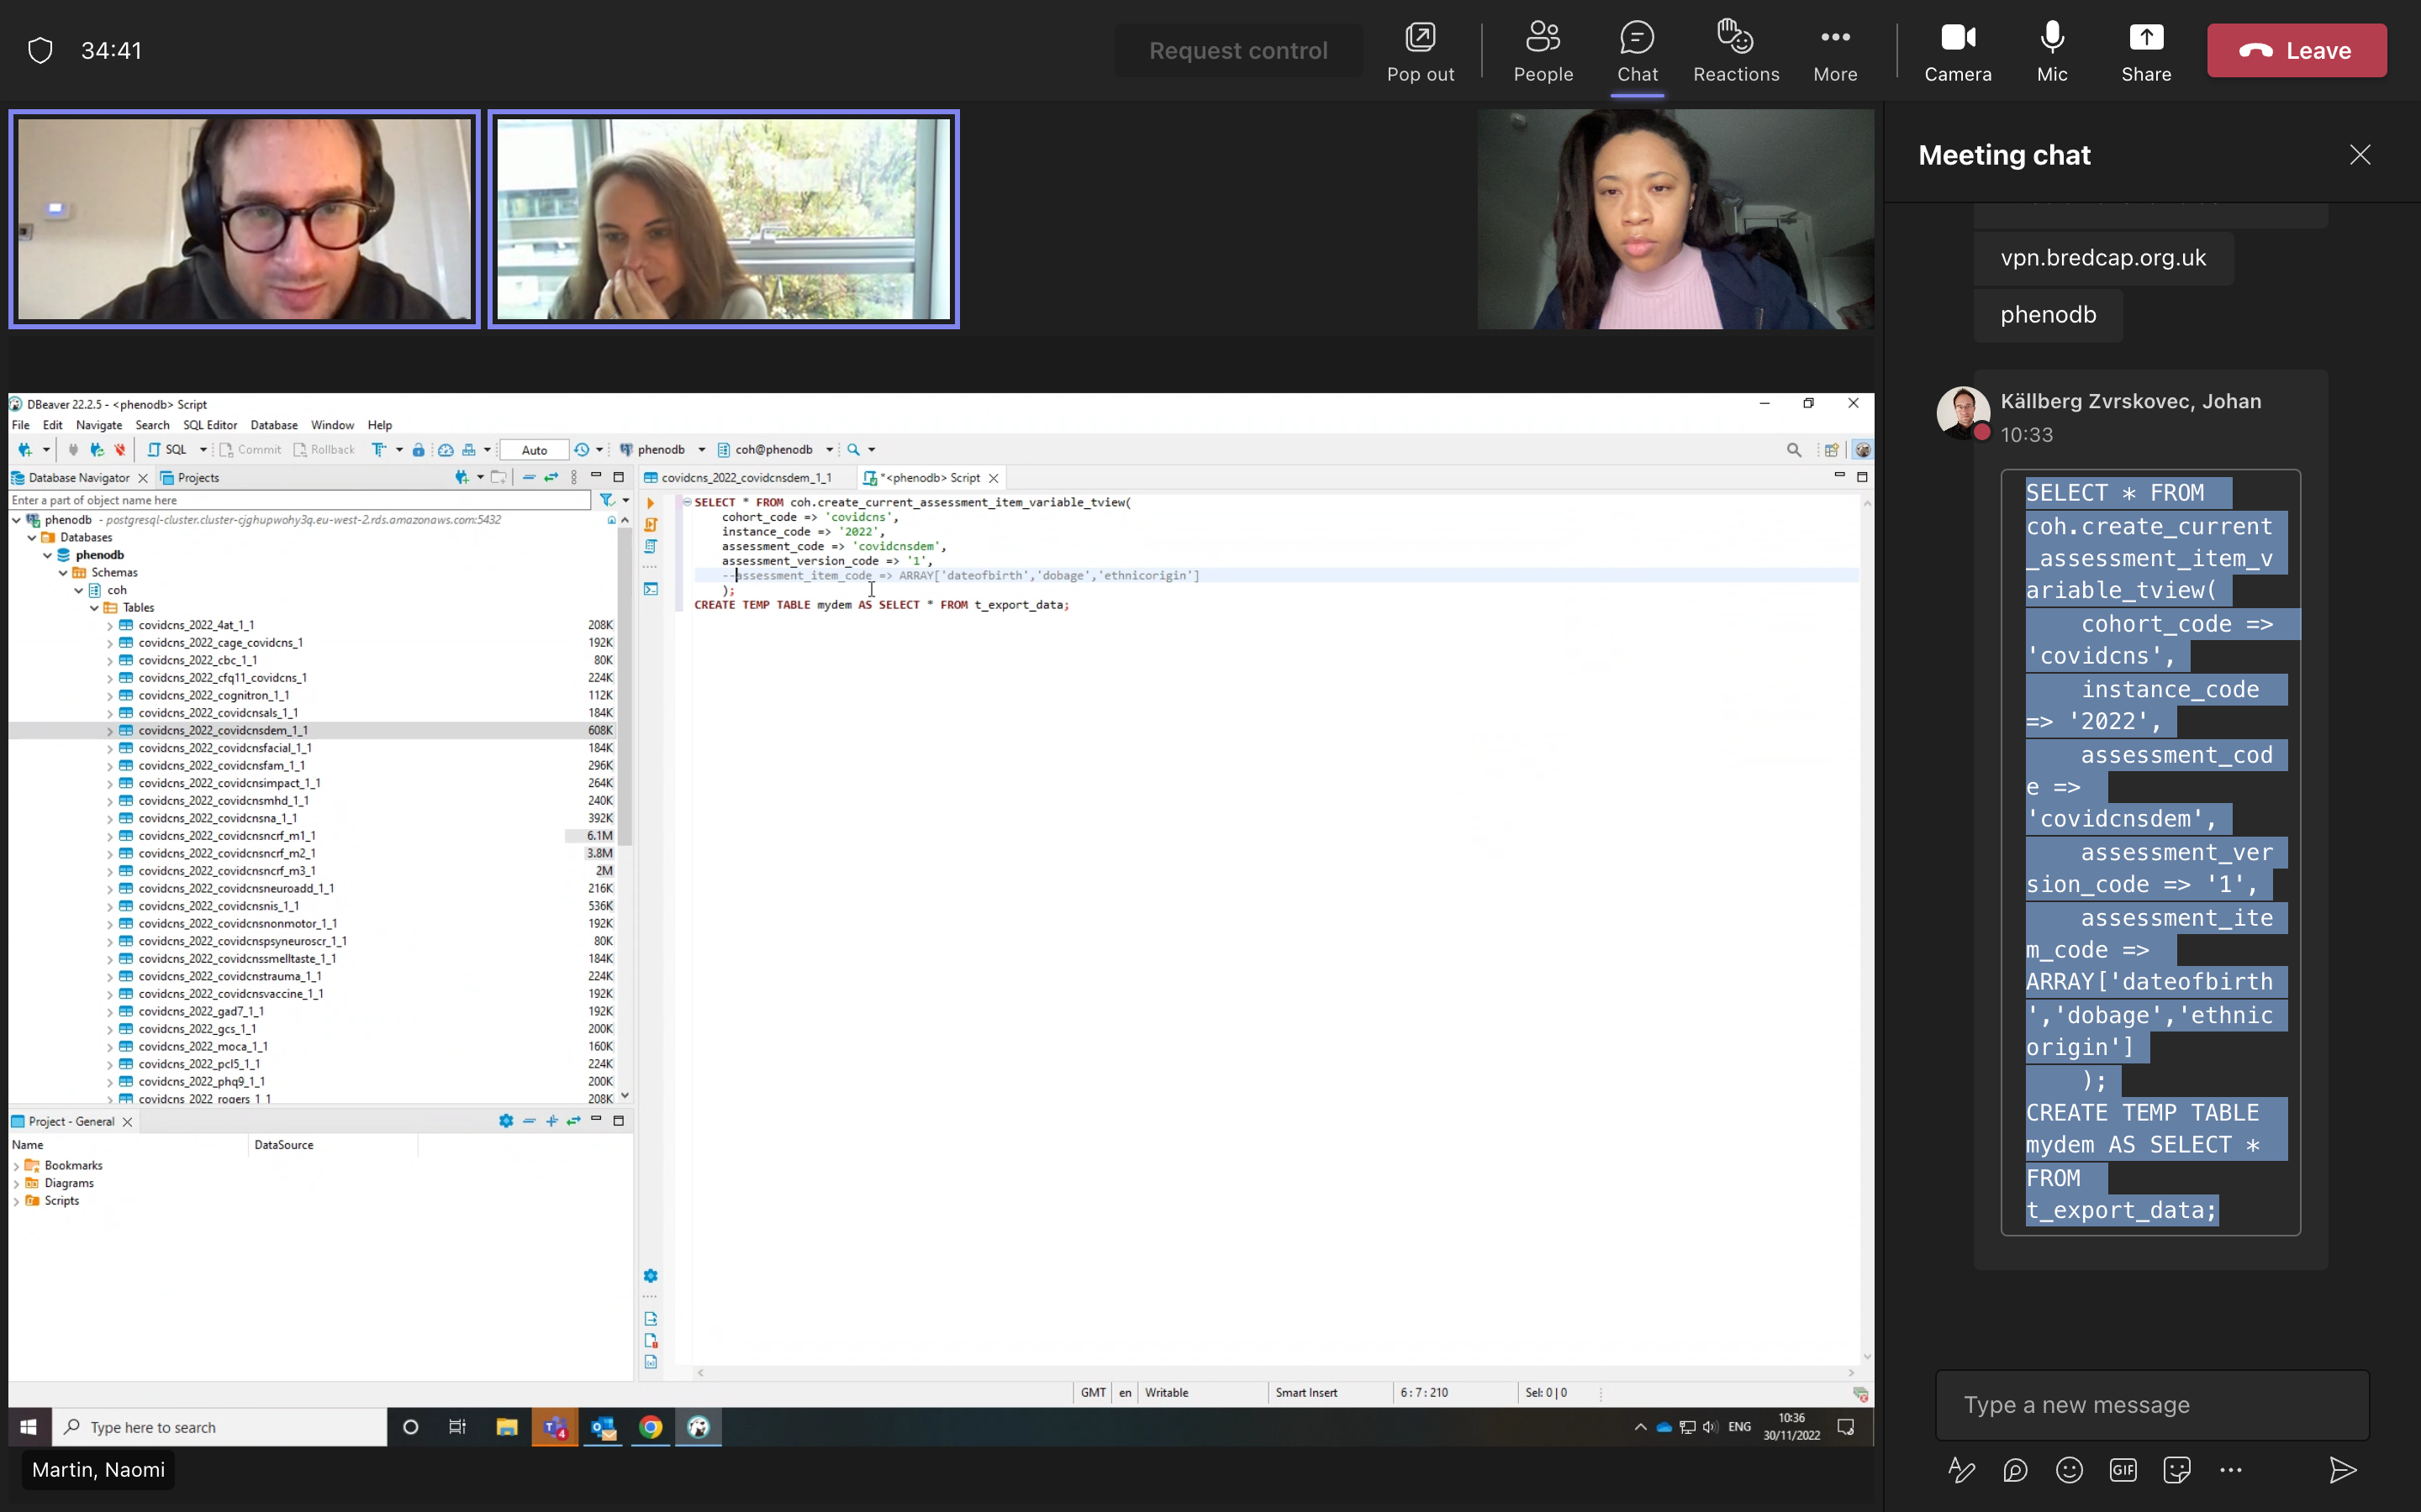
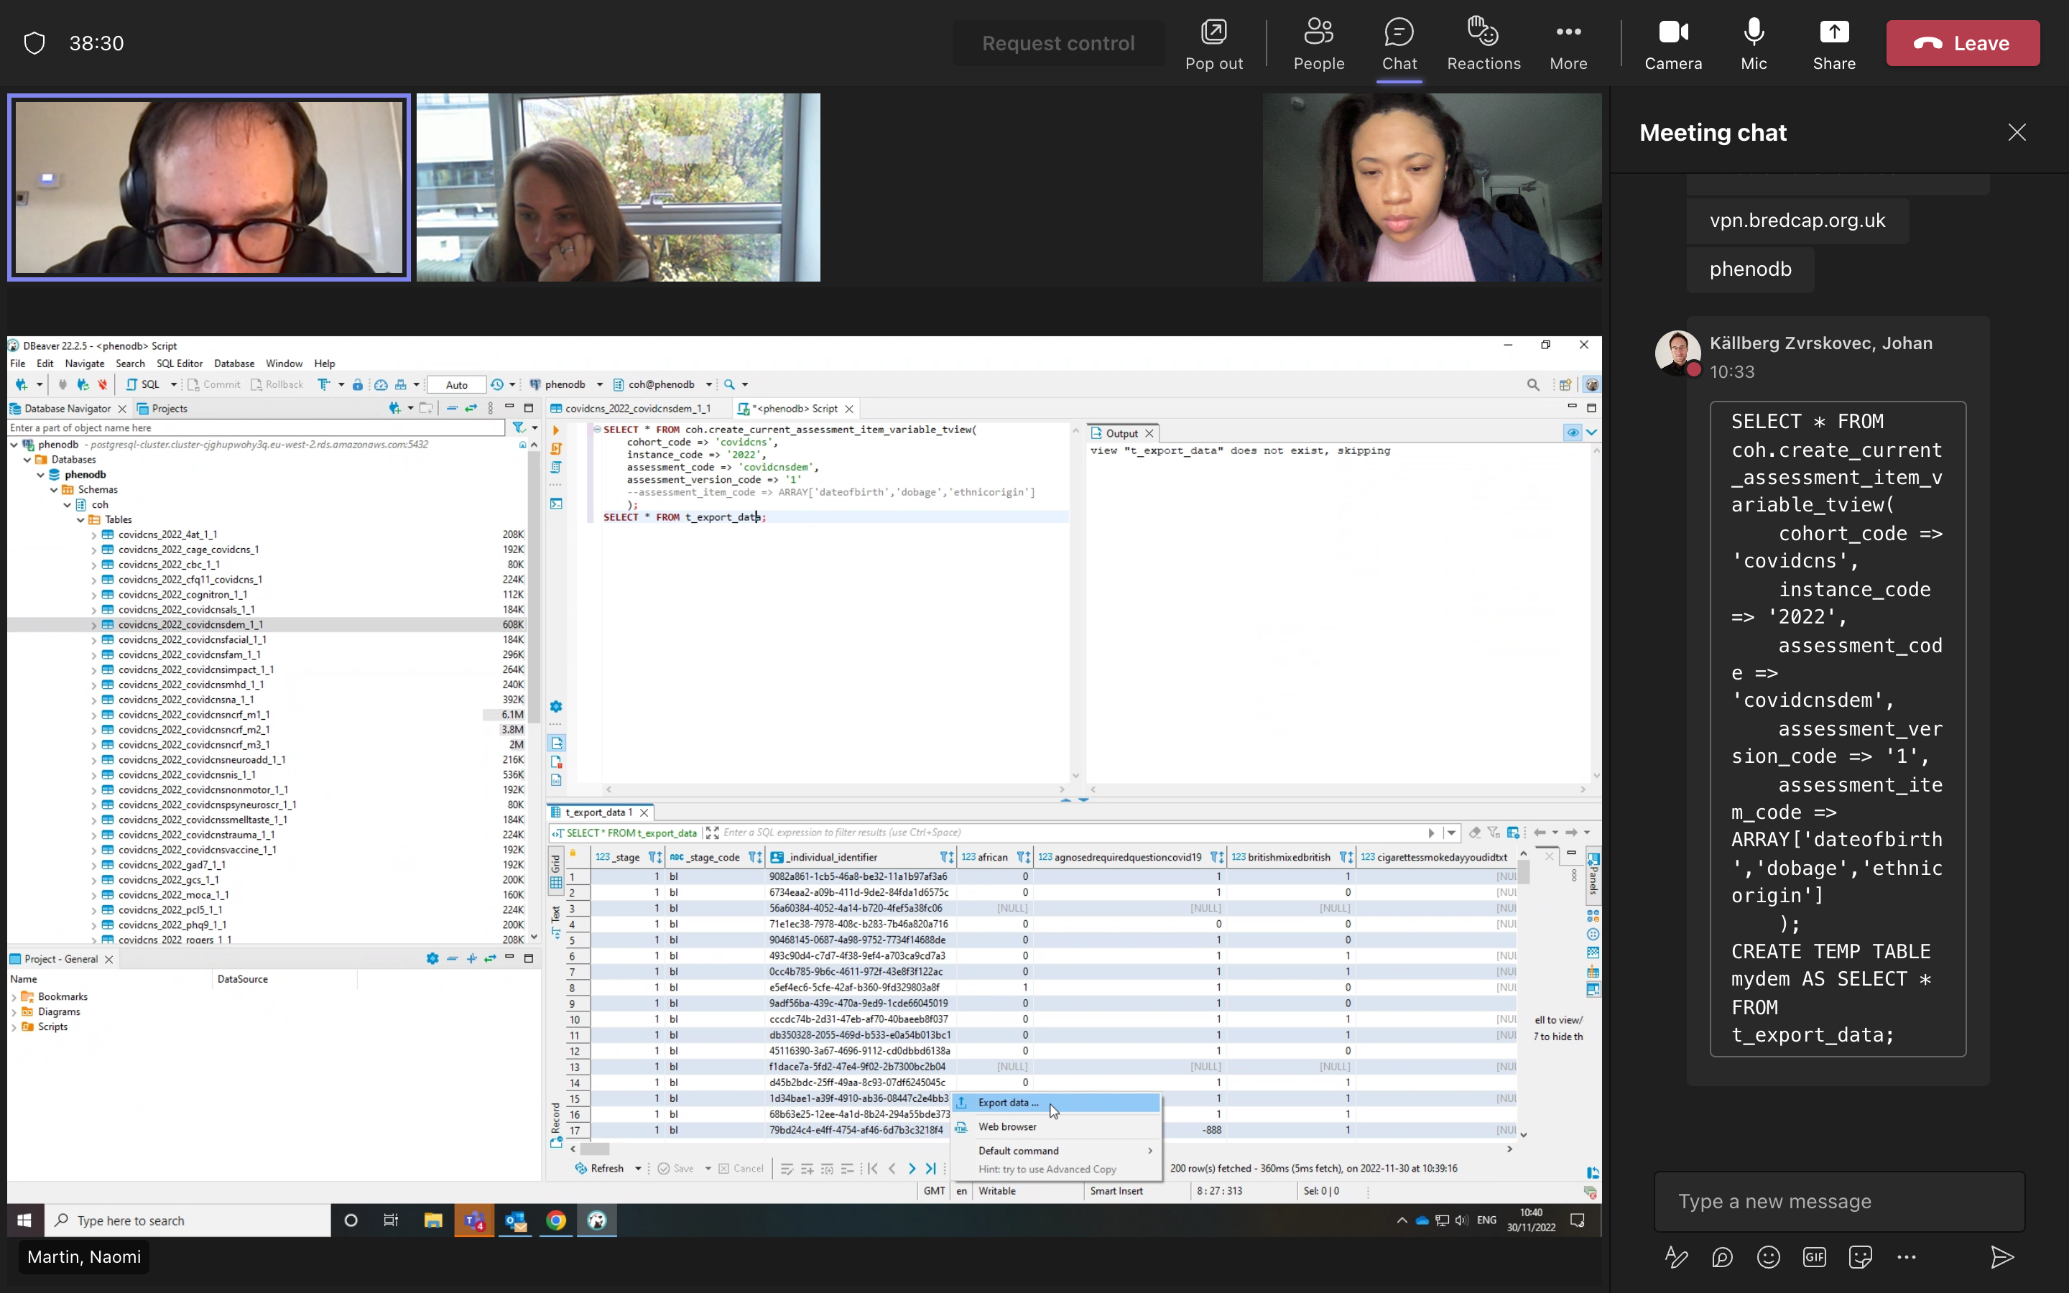
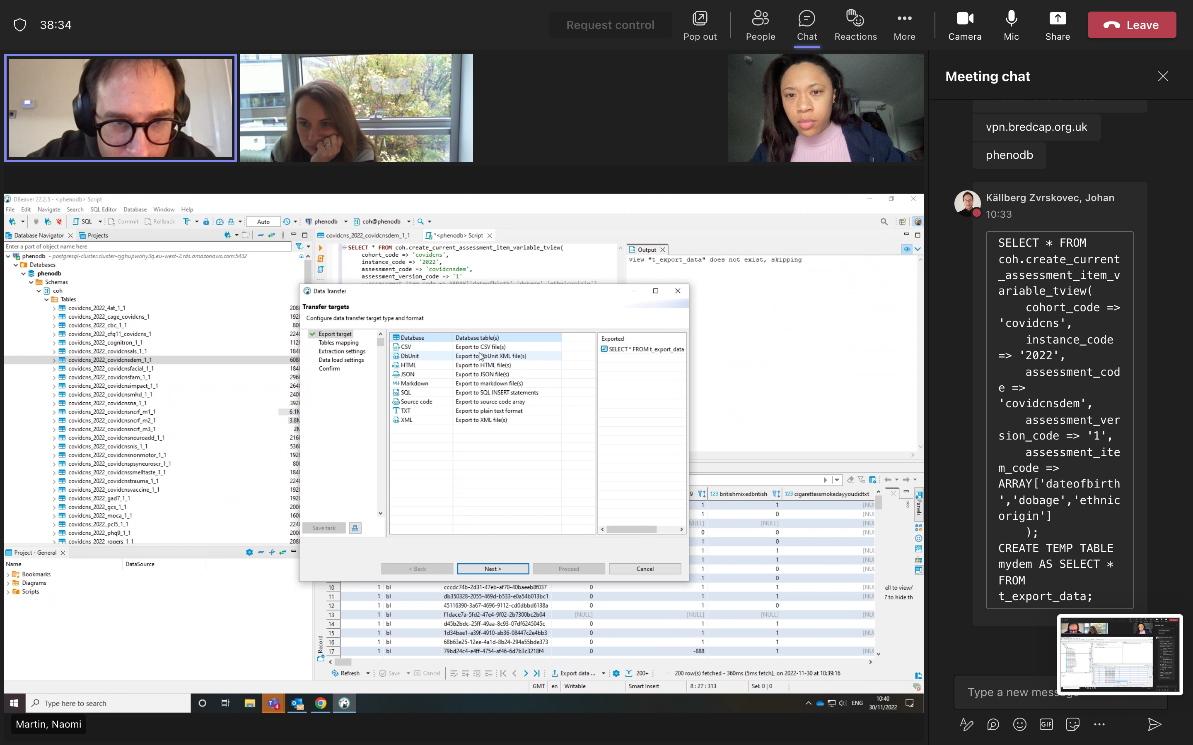
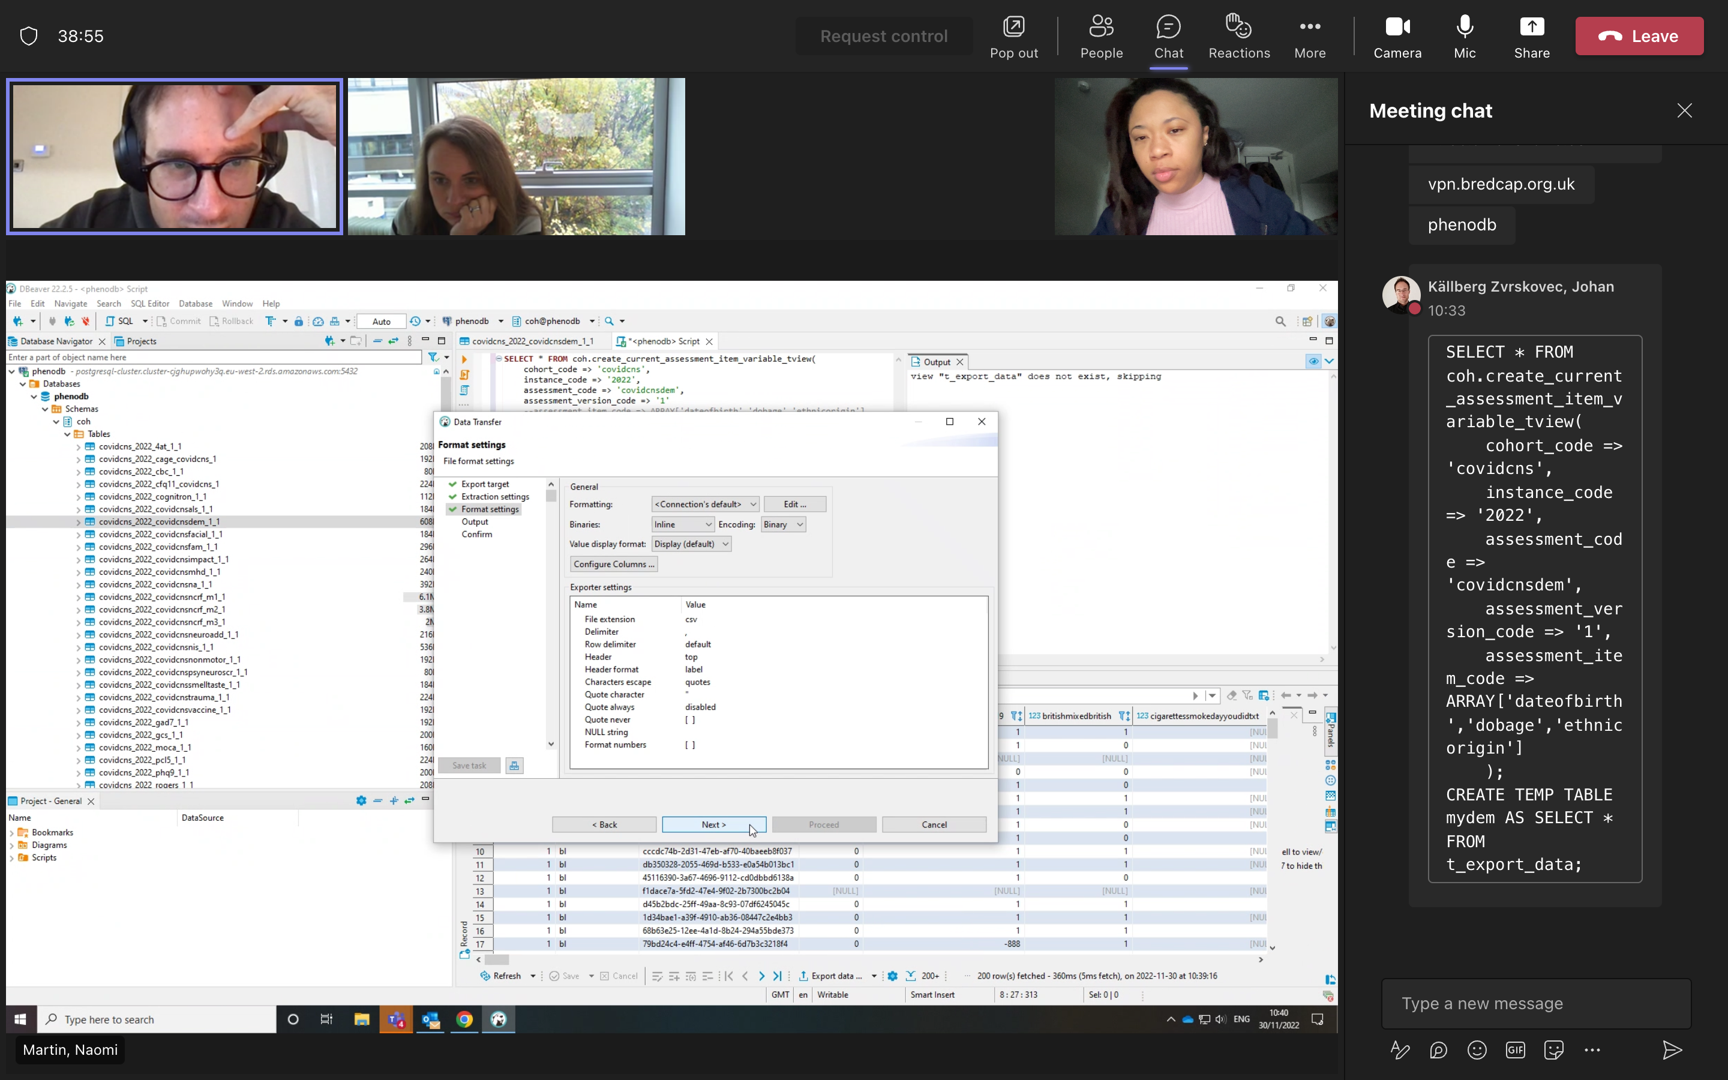
4. Extracting data
1
2
Select survey of interest and click “SQL” in upper left corner to open script page and enter code for extracting data (template on wiki/supplemental page).
3
Click export at the bottom to select export options and configure accordingly.
After entering code, click on “execute” button (second orange icon) to run script.
4
5
Continue to configure your export format (e.g. if selecting CSV format, you can choose value delimiters, quotation and column names).
Select export format (e.g. CSV, SQL).

Slide 9
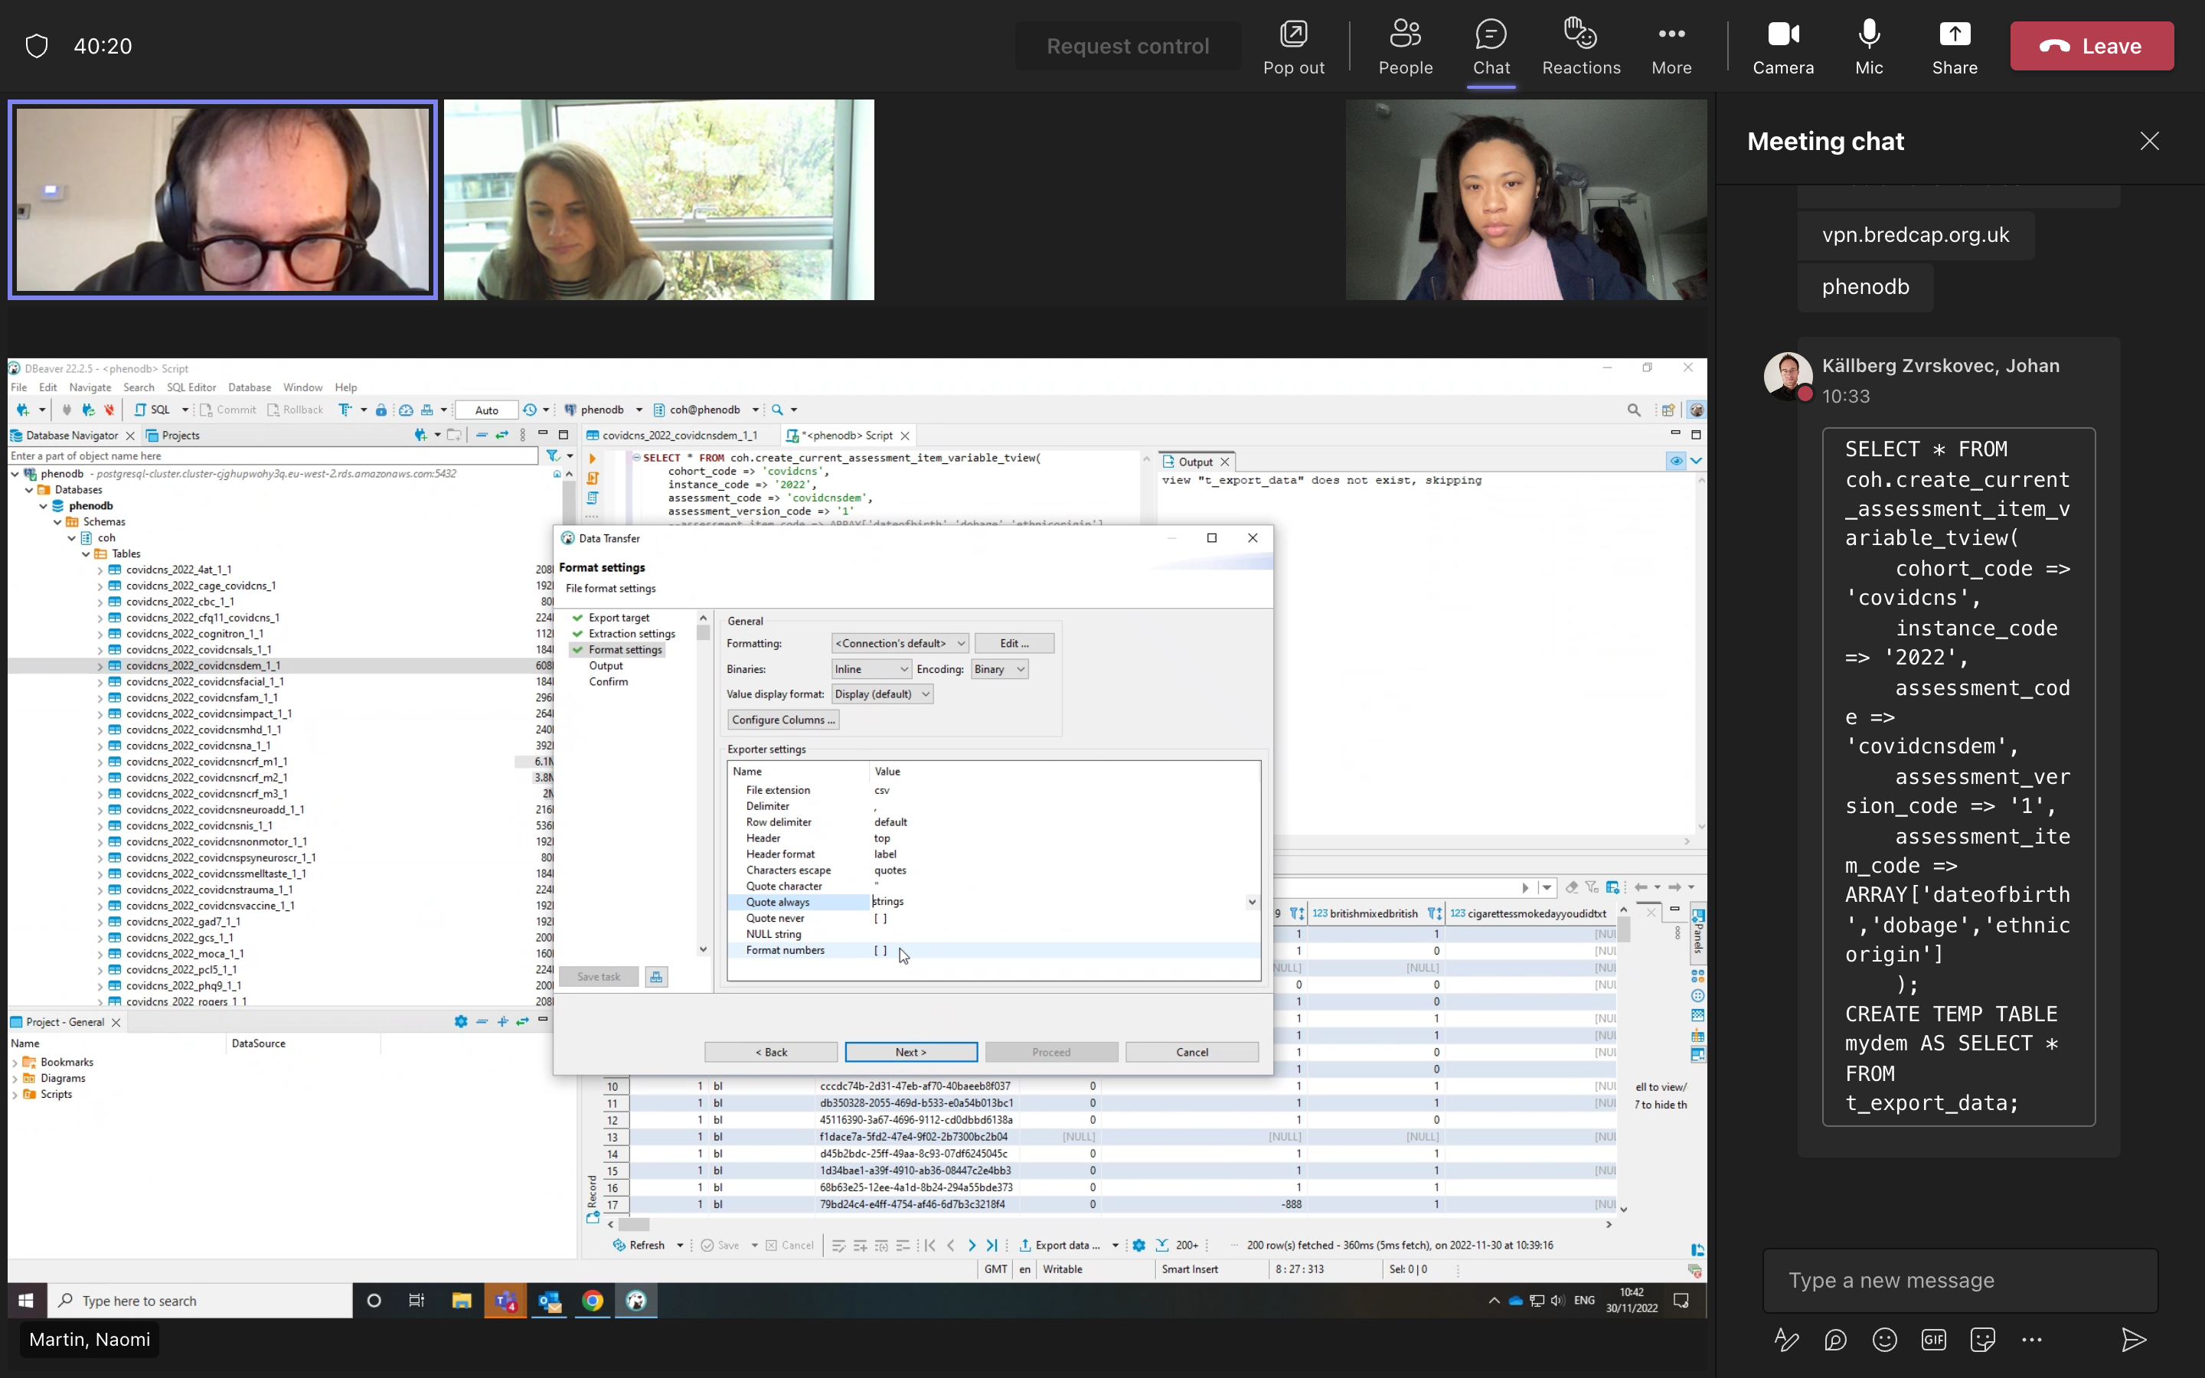
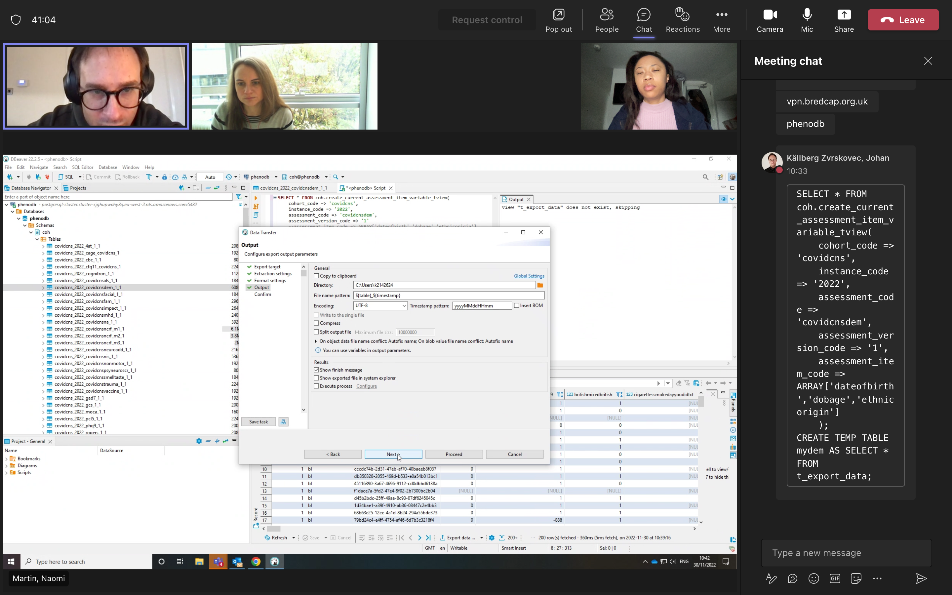
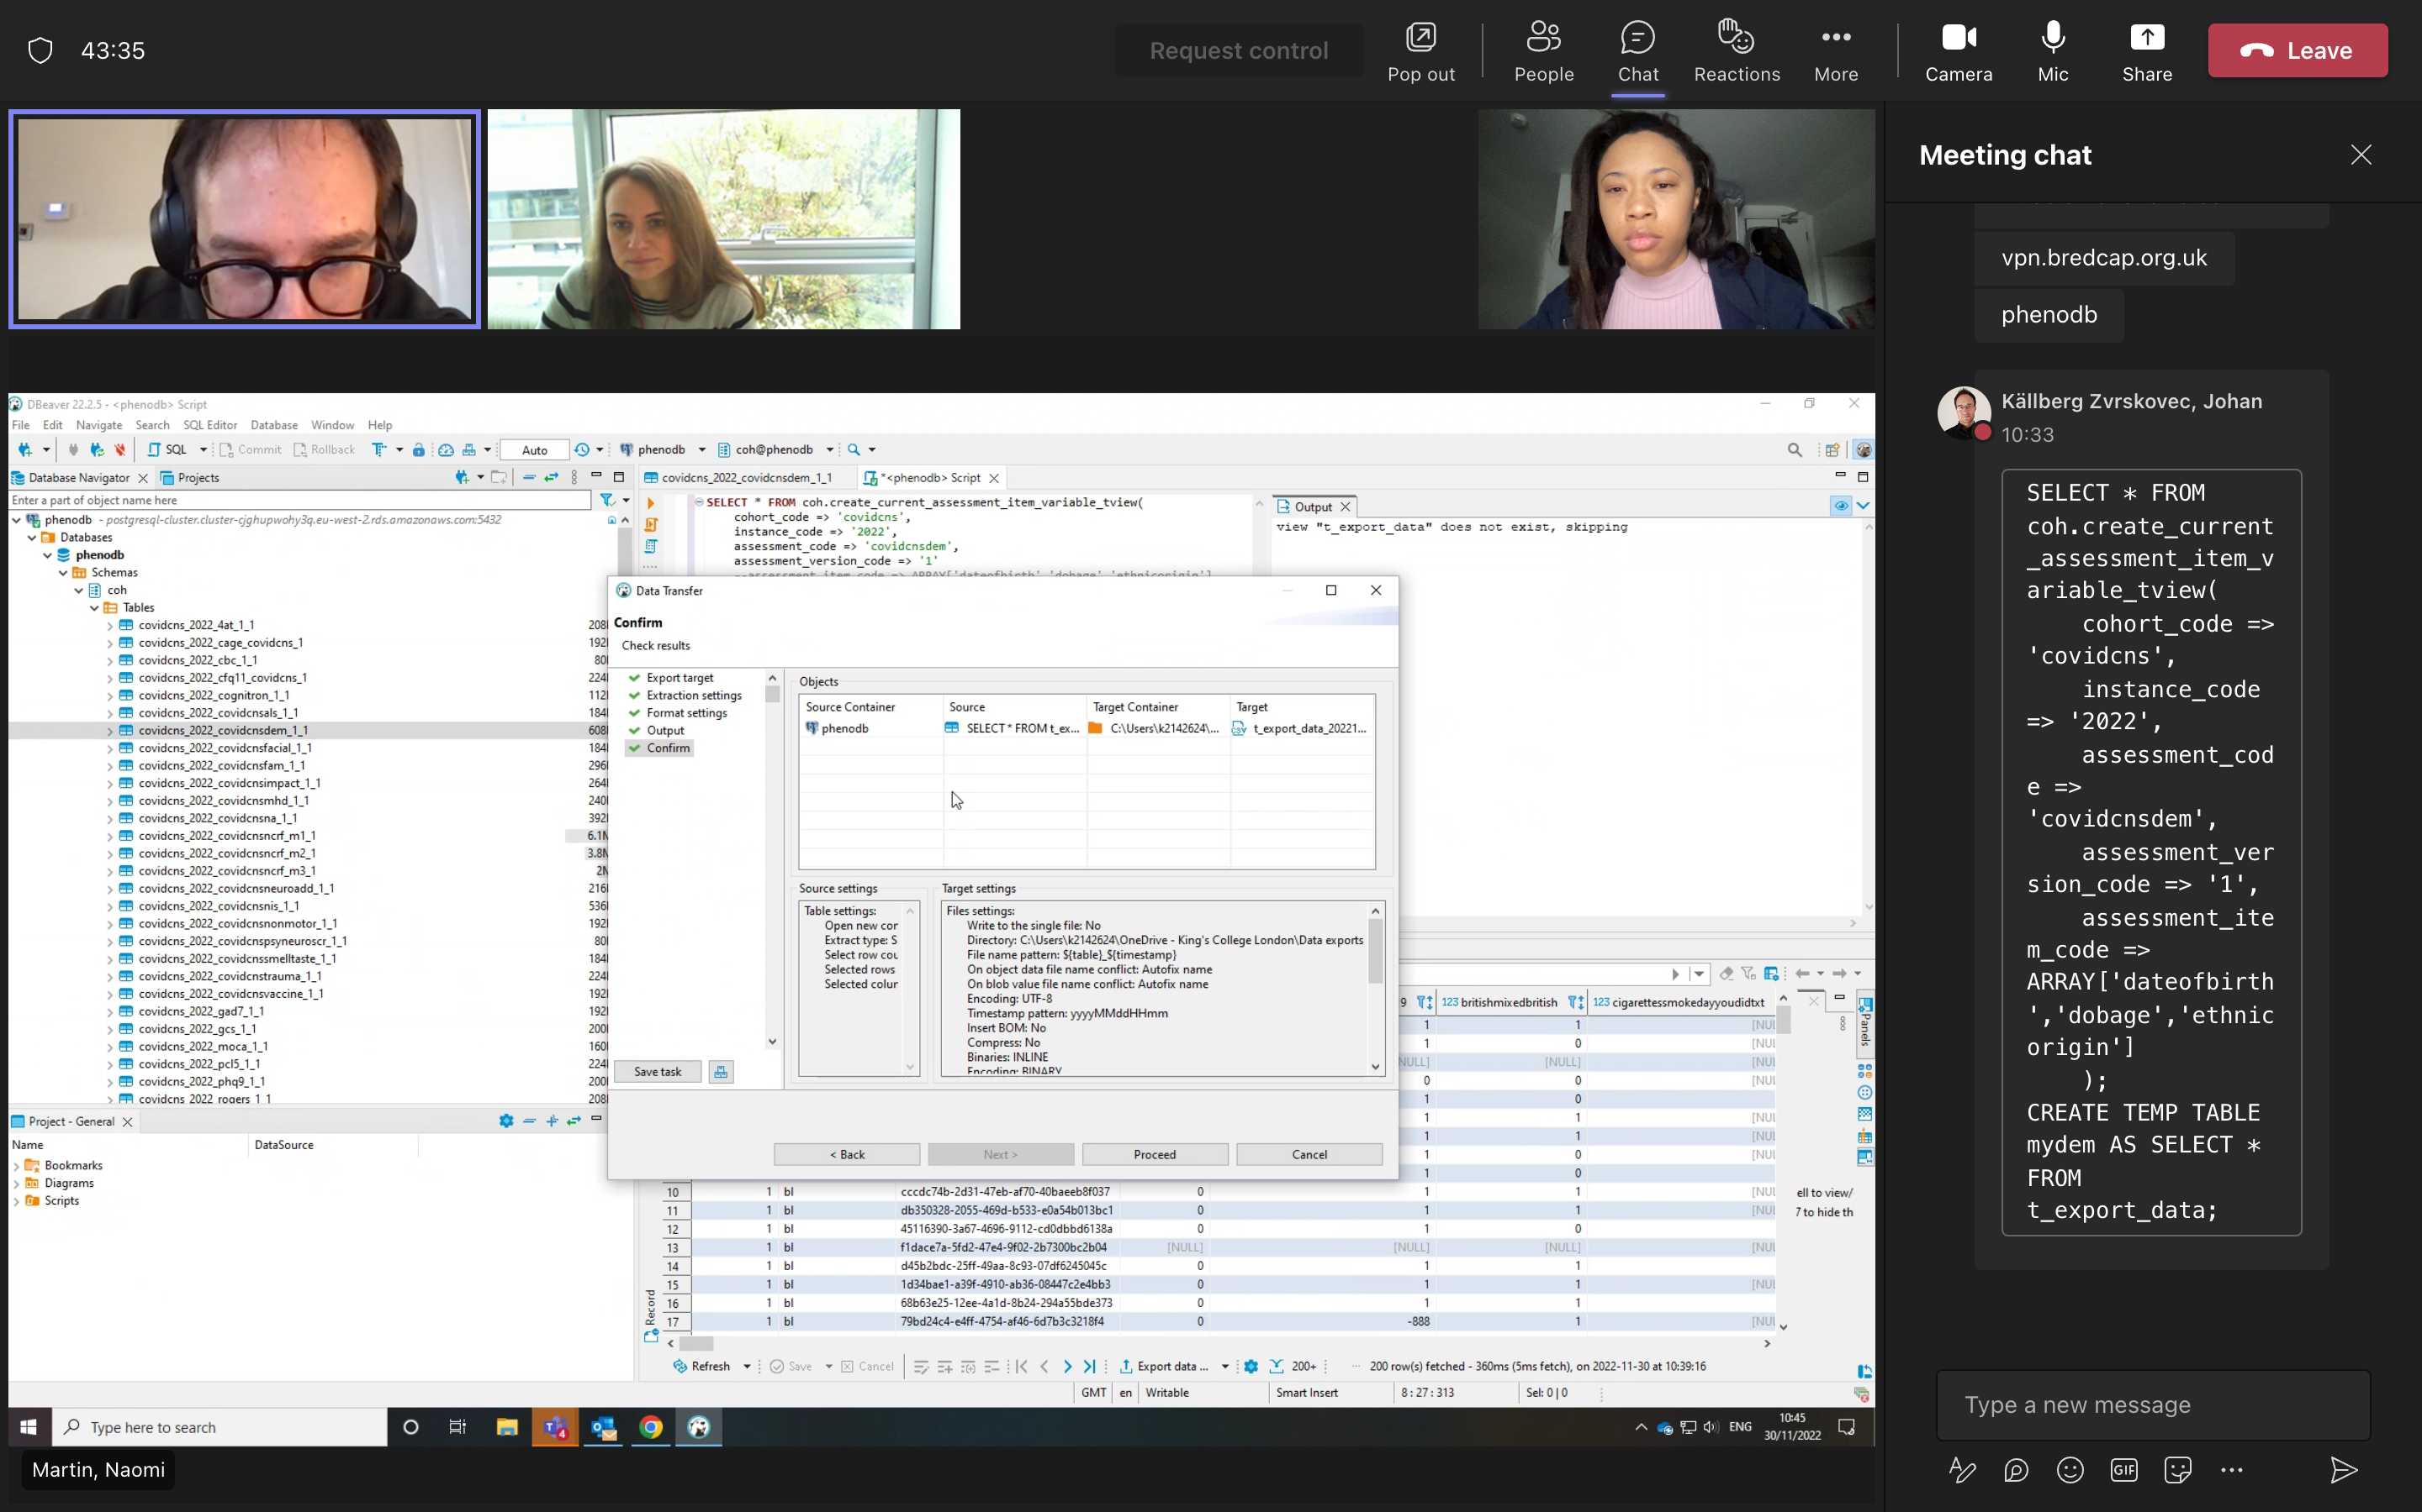
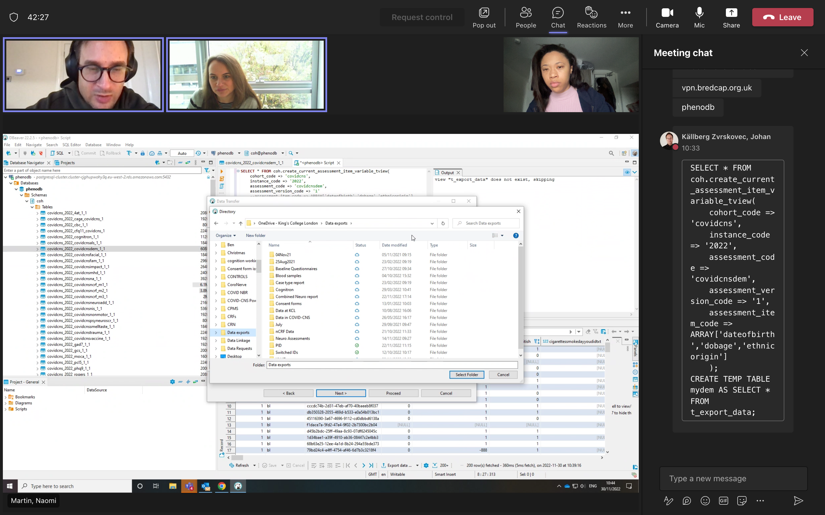
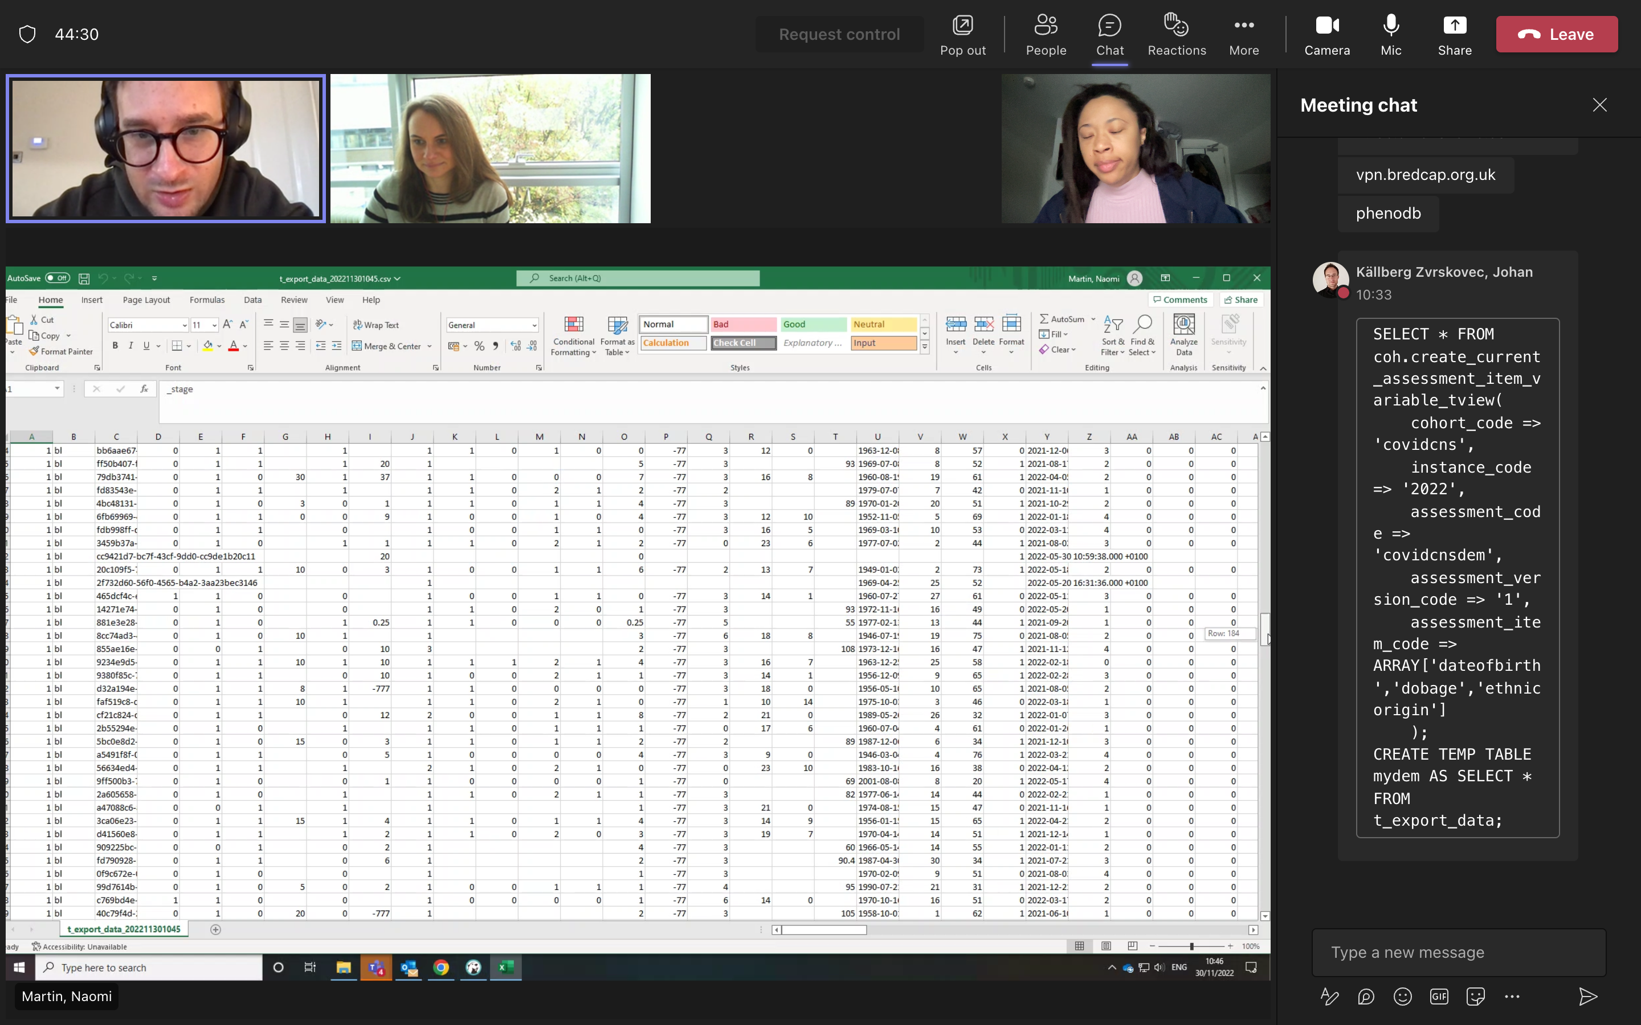
6
7
Select output target (e.g. you can copy to clipboard or select an output file, with or without compressing the file),
8
Press proceed to run the export. This may take a few moments to run.
Navigate to where you saved your exported file.
9
10
Open your file.

Slide 10
Helpful Links
Supplemental guide - https://github.com/tnggroup/gwas-phenotype-database-4-pgsql/wiki/PhenoDB-Connection-and-Usage-Instructions
This provides details (including the coding script mentioned in this guide) on extracting cohort data as well as providing further details for advanced users on how to work with the database using SQL or R.

